Slide 1
Revelation 21-22

Slide 2
v. 1-“Then I saw”-new part of the vision
New Heaven and new earth-Isaiah 65:17-25, [51:6, 66:22, 2 Peter 3:7, 10-15], Matthew 24:35, 5:18, Isaiah 24:5-6.
We saw earth and heaven flee from the presence of Jesus in Chapter 20:11. A consistent image with His return. It will signal the end to the old. Also Rev. 6:14, Hebrews 12:26-29.
Now God will create something new or at the very least, renewed. In fact, all of creation is waiting for this day-Romans 8:22-25. According to Isaiah 65:17, the former things will not be remembered.
What Isaiah pictures is a foreshadowing of the even greater new to come.

Slide 3
Will depart or go away or pass away-Rev. 21:1, 4, like v. 4-the first things have passed away. Usually the verb is used to describe someone going away or departing from one’s presence or following. (John 6:22, 66, 11:46, 20:10). A perfect tense usually implies the events are set in motion and continues into the future-Could be the idea found in Romans 8:20, Isaiah 24:5-6. It could imply the old is not necessarily destroyed, but goes away for the new to come. How some understand it. However other passages clearly speak of the old being destroyed. Revelation 20:11 seems to imply this as well.

Slide 4
Not actually the same word used in Matthew 24:35-the word there is one that means “to pass away as in disappear, come to an end.” Same word as Matt. 5:18, James 1:10-like a flower passing away. 2 Corinthians 5:17, Luke 21:32, Same word as 2 Peter 3:10-key understanding.
Look at 2 Peter 3 again.

Slide 5
The sea-as we have seen in Revelation represents a place of chaos and disorder. What the sea represents in Revelation will now be no more.
Read Brighton p. 593.
It could mean literal, but probably more what the sea represents-a symbol of spiritual evil.
Represents this in Rev. 13:1.
Leviathan coming out of the sea, and Rahab, which terrorize the human race (Job 41 & Ps. 89:9-10). In Isaiah 57:20-21, the wicked are likened to “the tossing of the sea”. Goes back to 12:17. Keep in mind John is on an island and the beast lay across the sea-it being Rome.

Slide 6
v. 2- “the holy city, the new Jerusalem.”
First reference to this city is in Rev. 3:12. It described that those who conquer in Christ will be like a pillar in the temple of my God. Also, they will bear the name of the city of my God, the new Jerusalem, which will come down out of heaven from God.
The holy city is mentioned in 11:2-trampled on for 42 months-debated whether that literally means the city of Jerusalem or as it represents the church. The context of Revelation would seem to imply the church.
This New Jerusalem is foreshadowed in the Old Testament-Isaiah 24:23, 25:6-9, 26:1-4, 19-20; 27:12, 60:14-Read Brighton p. 595-596.

Slide 7
Therefore, based on the details, we think this is the exalted church, who has been prepared by Christ for this day. It comes down out of heaven from God. The church had been raised for the Final Judgment. Now it will be brought down into whatever the new heaven and new earth represents. It definitely represents a new creation in which we will dwell. Now is it a planet, like ours? Will it be something else? Will there be a universe surrounding it like before? It is all a mystery, but we are given some of the details of it in Revelation 21-22.

Slide 8
What tips the cap that this represents the church is the reference to it being like a bride that “has been and continues to be prepared as a bride adorned for her husband.”
The word prepared is found in many important passages.
Matt. 20:23-place prepared by the Father-those on his right
Matt. 25:34-placed prepared from the foundation of the earth (both references to the time after the resurrection and Final Judgment)
John 14:2-3-Jesus prepared a place for us in His death
Also I Corinth. 2:9, also Hebrews 11:16-Now is Hebrews 11:16 implying that the New Jerusalem is just where the church will dwell in the new heaven and earth or is the church the city itself? Either way, all those passages show that God the Father, through Christ, prepared it for us.

Slide 9
In Rev. 21:2, it is the city that is prepared. How is it prepared?
It is adorned as a bride. This connects with Ephesians 5:2-27. Clearly in Ephesians 5, the bride is the church.
In the OT, Israel is described as the bride of Yahweh. Therefore, the people are the bride. He adorns his people.
Isaiah 54:5, 61:10-11, 62:5, Jeremiah 2:2, 3:1, Hosea 2:19, 3:5. Isaiah Chapter 54-Key context-Look at.
Other references in the NT-2 Corinth. 11:2, 2 John 1:1, 5.
Jesus describes himself as the bridegroom in John 3:29, Mark 2:19.
Having been and continuing to be Adorned-where you get the English word cosmetics from. Perfect tense.
Like Isaiah 54:11-12.

Slide 10
v. 3-We hear another mega voice from heaven or the throne-Frequent in Revelation.
v.3-the dwelling place-literally the word for tent or tabernacle. God will tent among his people again. p.597 in Brighton. Also, word for tent in Matt. 17:4-Transfiguration, Tabernacle-Acts 7:44, Exodus 26 & 40, Numbers Chapter 4-word used frequently. Or like mentioned in Hebrews 8:2, 5; 9:11, 21. Mentioned earlier in Revelation in 13:6, 15:5.

Slide 11
It is getting back to the relationship we had with God before the fall, where we were in perfect communion with Him. We could be in His actual presence.
Dwelling with them or tabernacling with them-John 1:14, Rev. 7:15.
Dwelling with men and being their God-Goes back to the OT. Lev. 26:11-12, Jeremiah 31:33, 32:36-41, Ezekiel 37:24-27, 11:19-20, 14:11, 36:28.
It was the relationship God had with man in the Garden and He wanted to restore through the old Israel-Exodus 19:5-6, Deut. 7:6, 4:20.

Slide 12
v.4-wipe away, as in remove or erase-Rev. 7:17, as in reference to tears. As in reference to sins, Acts 3:19, Colossians 2:14-
Tears-Like in Isaiah 25:8, Rev. 7:17- Brighton p. 598-
And the death will not still or yet be-Like that mentioned in Rev. 20:6, 13, 14, I Corinth. 15:54.

Slide 13
Mourning as in sadness or sorrow.-Rev. 18:7-8
Crying-wailing or shouting in grief or anxiety-Not always because of sorrow, but just crying out because of something-Similar to Isaiah 65:19
Pain in any form whether it be from hard labor or affliction.
Because the first things-all associated with the first earth, the fallen first earth, will be gone because it has departed or gone away-same word as v.1.

Slide 14
All things new-Brighton p. 600-601. Isaiah 43:19, 42:9, 48:6. Jeremiah 31:31-34, Mark 2:18-22.
2 Corinthians 5:17-already begun, but now completed. Ephesians 2:15, 4:22-24, Colossians 9-10,
Command-“write”-four other times in Revelation 1:11, 19, 14:13, 19:9
Faithful and true-Brighton p. 601-602.
Truly, Truly, I say to you-Jesus. 1:5, 3:14, 19:11.

Slide 15
v.6- ge,gonan-it is and continues to be…Not the same word as Jesus spoke from the cross. Or it has begun and continues to be. Read Brighton p. 602
“All that God has spoken of regarding the making of all things new and regarding the restoration of the new heaven and earth has come about. All is now done. It is done. There is nothing to be added.”-p. 602

Slide 16
alpha & omega-first and the last of the Greek alphabet-Rev. 1:8, 22:13. Read Brighton p. 602-603.
beginning and end-Rev. 22:13
drinking from the living water-Isaiah 55:1, John 4:10-14, 6:35, 7:37-Rev. 22:1-Complete and full access to the Holy Spirit and its full power and gifts and all the blessings it bestows. We possessed the Holy Spirit on earth, but it was still surrounded by a flesh of sin. Now we will be a complete spiritual being, with no sin, and thus completely and entirely guided and filled with the Holy Spirit.
We could think of I Corinthians 15:42-49.
Jesus offered this invitation on earth, now we receive its full benefit.
without cost, or without payment, or as a gift.

Slide 17
v.7-the one who overcomes or is victorious (vikwn)-goes back to the letters to the churches. I John 5:4-5
Will inherit-same word as Matt. 19:29-exact word- Also, Gal. 4:30, Matt. 25:34.
The noun form is found in Isaiah 54:17, Luke 20:14, Gal. 3:18. They are heirs of salvation. Full rights as sons.
He will be my son-Theme in I John 2:28-3:1, Galatians 4:4-6, 30, Romans 8:14.-Born of God theme-in John. Hebrews 12:5ff.

Slide 18
v.8-cowardly, timid-2 Timothy 1:7-8-same word family-Look at foot note in Brighton p. 604.that kind of idea. The only other times those words occur in Scripture is Matt. 8:26, Mark 4:40 when Jesus calls his disciples cowards when their fear of a storm threatened to overpower their faith. It probably represents unbelievers with no faith in Christ, although it might describe those who were Christians at one time, but later they cowered in the face of persecution and joined the company of unbelievers. They chose personal safety over faithfulness to Christ.”
Like Matthew 13:20-21-seed upon the rocky place

Slide 19
The unbelieving or faithless
Detestable or abominable-doing detestable or abhorrent things in God’s eyes-Examples-Deut. 18:9-14, Lev. 18:20-30, 20:13.
Murderers-Matt. 22:7
Pornois-
Sorcerers-where you get the English word pharmaceutical from. Same word used in Exodus 9:11
Idolaters, and all the false ones (pseudo ones).
All have their part in the lake of burning fire and sulfur or brimstone-20:10, 14. This is the second death.
Similar lists in 21:27, 22:15

Slide 20
v.9-one of the seven angels who had the seven bowls full of the seven last plagues-16:1.
How did John recognize which angel was which that spoke to him? Were they distinct? Recognizable as separate angels? You would think.
“Come or come here”-
It shows that the bride that had been prepared for her husband in vs. 2, the New Jerusalem, is also the wife of the Lamb.

Slide 21
The church has now gone from being just betrothed to Christ-2 Corinth. 11:2, to now being fully His bride.
Matthew 22 and the wedding feast thrown for the Son and Matthew 25-the bridegroom coming for His bride both are depicting the day of Christ’s return where He would come for His betrothed bride and make her His wife in the resurrection. Thus, the marriage feast of the Lamb in Rev. 19. It is the heavenly celebration of the official marriage. It further cements the fact that the New Jerusalem represents the exalted church.

Slide 22
v.10-in the Spirit-1:10.
Not the only person to have this happen-Acts 8:39-Phillip; Elijah-I Kings 18:12, 2Kings 2:16, Ezekiel-3:12, 14, 8:3, 11:1, 24, 43:5, Paul-2 Corinth. 12:2.
To a great, high mountain-Perhaps a reference to the mountain of the Lord mentioned over and over in Isaiah-representing Christ’s kingdom.
Isaiah 2:2-5, 11:9, 25:6, 56:7, 65:25, Joel 3:17-18, Zechariah 8:3
Now once again, is this a literal mountain or a figurative mountain? Good question.

Slide 23
v. 11-The New Jerusalem is “having the glory of God”.
The glory is the radiance of God-We can think of Moses radiating the glory of God when he came down off the mountain-Exodus 34:29ff.
Jesus-at His Transfiguration-Matt. 17:2.
“the radiance”-fosteir-star-light-compound word of light and star. The light it is radiating. Used in Phil. 2:15 for a star. A heavenly body that generated its own light.
Brighton- “Here in 21:11 John sees that adornment as ‘the glory of God’ because of Jesus Christ, but it is unseen to the human eye. Now, after the resurrection and the restoration of heaven and earth, the church is adorned with this glory for all to see.”-p. 609-610.

Slide 24
It is like a precious stone, like jasper, clear or translucent as crystal. The English word jasper comes from this Greek word.-Also in Rev. 4:3

Slide 25
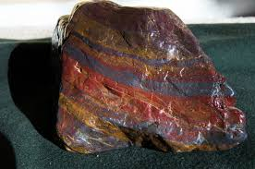
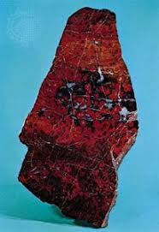

Slide 26
v. 12- “A great, high wall”-Like the original city of Jerusalem.
Show picture-p. 493 in Lutheran Study Bible. David took the stronghold of Zion, which was a city of the Jebusites that David conquered-2 Samuel 5. He made it into his capital. 2 Samuel 5:9.
Later, Solomon expanded the city to include the site of Abraham’s altar-Mt. Moriah and built the temple there. Show picture-p. 548 in Lutheran Study Bible.

Slide 27
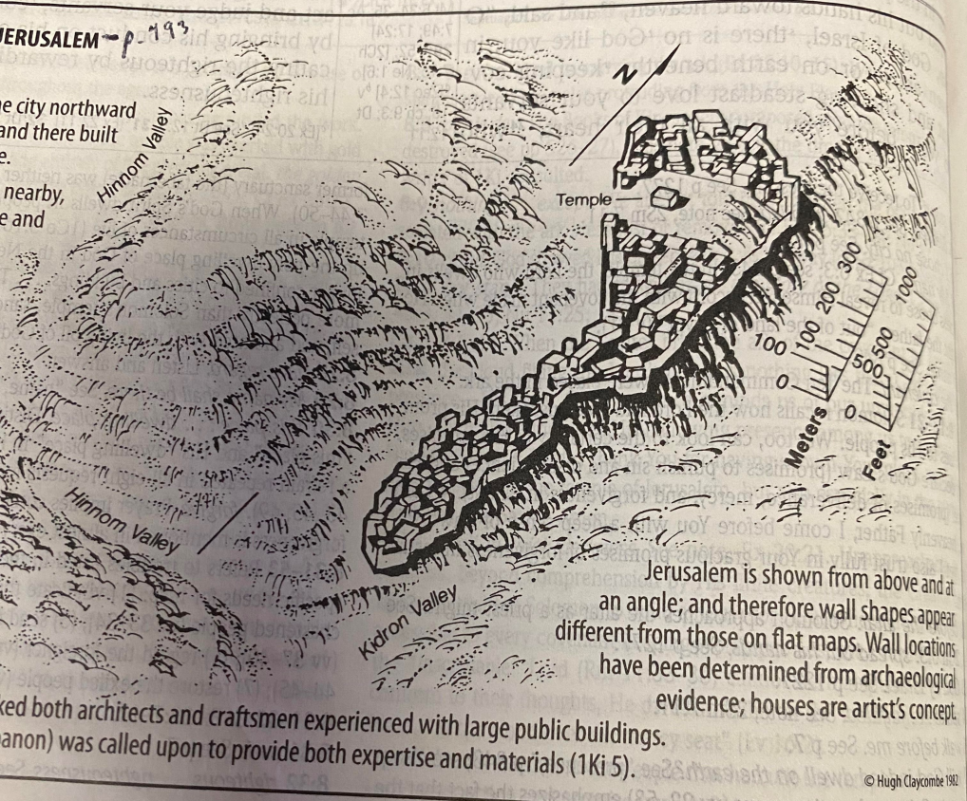

Slide 28
The walls had a history-The walls around Jerusalem were broken down during Babylon’s siege in 2 Kings 25:10. Nehemiah then headed up the rebuilding of the wall project in Nehemiah. It was completed-Nehemiah 6:15-7:4. The gates were to be opened only during the day and shut at night.
Why does the city need walls? What might they represent? Read Brighton p. 610ff.

Slide 29
12 gates-Unusual for ancient cities
Brighton- “It was common for ancient Near Eastern cities to have only a single gate because the gate was more vulnerable to attack and was more difficult to defend than the wall. The twelves gates of the new Jerusalem ‘symbolize abundant entrance.’-p. 611.
This fits the vision that Ezekiel received of the restored, rebuilt temple and holy city. Ezekiel 40-48. In Ezekiel 48, it says that this city will have 12 gates with the names of the 12 tribes of Israel on them. Now who are the 12 tribes of Israel now? Represents the church. We saw this in Rev. 7, as the 144,000 is described as the sons of Israel. The ones sealed by the angels. It could include the Old Testament believers as the first “church”.

Slide 30
v. 14-12 foundations or foundation stones-
We could think of the 12 memorial stones placed in the Jordan after the nation of Israel passed into the Promised Land. It was to remember the day the Lord entered the land by way of His ark and his parting of the water to do it.
It could represent Ephesians 2:19-22. The church was built upon the foundation the prophets and the apostles with Christ as the chief cornerstone. Further evidence that this city represents the church. -Allusion to this city in Hebrews 11:10.
Because the names of the apostles are written on those stones. Both testaments are represented, yet one common story.

Slide 31
v. 15-Why the measuring? Connects with Ezekiel 40:3ff. This man whose appearance was like bronze has the measuring reed in his hand-Connects perhaps with the figure in Revelation 10. Is this Christ? Is it an angel? An angel in Revelation.
We see this also in Zechariah 2:1-5. Read about the potential purpose of this measuring-Brighton p. 614.

Slide 32
v. 16-foursome-Square or cube was considered the perfect shape. A perfect cube.
Measured 12,000 stadia- A Greek “stade” measured 600 Greek feet (625 Roman feet), the equivalent of around 607 English feet. It would equal about 1,380 English miles. Thus the city would be about 1,380 miles long, and wide and high.
Brighton- “Whatever one makes of these measurements, the size and scope of the holy city Jerusalem in Rev. 21 certainly declares that it is all encompassing in its perfection and splendor.”-p. 615.
It would be roughly the distance from New York City to Miami, FL to Lincoln, Nebraska. The whole Southern portion of the United States, but also it would be that high.

Slide 33
The walls themselves would be 144 cubits-roughly 216 feet or 72 yards. 144-square of 12. representative number.
v. 18-the city radiated like jasper because the walls were built of jasper. The city streets were made of gold.
The foundation stones are listed. A stone representing about every color.
Once again, this connects with Isaiah 54:11-12.

Slide 34
Jasper-Can be many colors-they say the rarest is green.
Sapphire-Can be found in many color types, but typically thought of as a blue hew.
Agate-can have different colors-different type of rock-formed within volcanic and metaphoric rock.
Emerald-green in color.
Onyx-Usually has light and dark bands-black and white.
Carnelian-typically orange or reddish hew.
Chrysolite-Can be different colors, but a green or orange or yellow hew is typical.
Beryl-Can be many different colors
Topaz-A brownish color.
Chrysoprase-Greenish stone
Jacinth-reddish stone
Amethyst-purple stone.

Slide 35
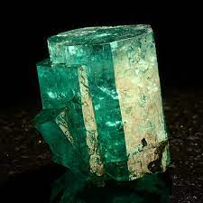
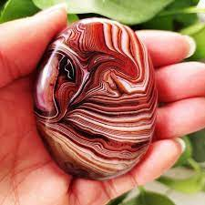
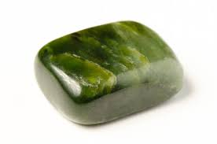
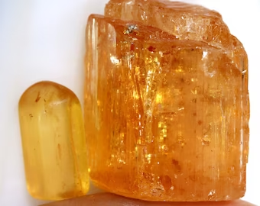
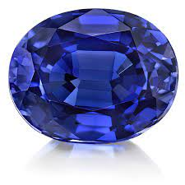
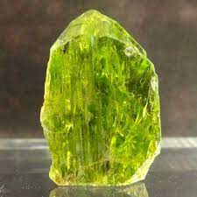
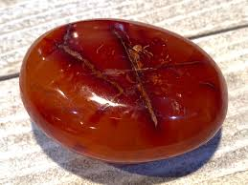
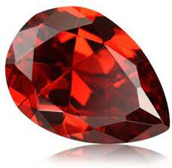
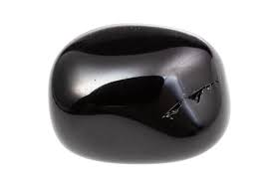
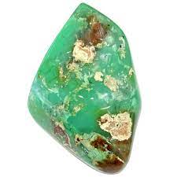
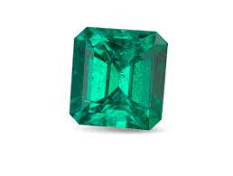

Slide 36
v. 21-Twelves gates were twelve pearls-One of the rarest and most expensive finds on earth. Made of a single pearl-One big pearl.
Street of gold. Street fit for a king.
v. 22-Does not see a temple in it-Read Brighton p. 618. Temple-vaos-as in the innermost part of the temple, the sanctuary- No need for a specific place for God to dwell in the city because he is everywhere and can be seen. The Father and Jesus are the temple for the people.
Jesus alluded to this in John 1:14, 2:19ff. Matt. 12:6-”Something greater than the temple is here.”.
Ezekiel 37:24-28.

Slide 37
v. 23-God’s glory provides the light. Like in Isaiah 60:14, 19.
Jesus of course-the light of the world-John 1:9, 8:12, 3:19, 12:35.
Plus, the tracking of time is not necessary, which was part of the reason why the Lord created the sun and moon. The light no longer needs to be governed. The light or glory of the Lord radiates into every part of the new heaven and earth.

Slide 38
v. 24-Nations walking by the light-Isaiah 2:1-5, 9:2ff, 60:1-6, Psalm 118:27-John 3:19, 11:9-10, 8:12.
Kings of the earth-Brighton- “Lenski is correct when he says that ‘the nations’ are the glorified saints, and that the term ‘the kings of the earth’ is used to ‘convey the idea that not all these powers of the earth were won for Satan, but that the Lamb, too, won many of their number for himself.”-p. 620

Slide 39
v. 25-the gates will never be shut-Read Brighton p. 621. Signifies that all the enemies of the church are gone, there is nothing to fear. All have access to God and His presence freely.
Echoes Isaiah 60:11.
v. 26- “The purpose of them remaining open is so that through them the wealth of nations and their kings may be brought into the city in a worshipful procession. They will all honor and worship the Father and Jesus, the Son.

Slide 40
v. 27-Unclean-Why would anyone be unclean? Due to sin. Jesus reveals this in Mark 7:14-23. What comes out of a man, due to his sinful nature, is what makes one unclean.
Examples he lists-evil thoughts, sexual immorality, theft, murder, adultery, coveting, wickedness, deceit, sensuality, envy, slander, pride, foolishness.
Nothing considered sinful will ever enter into his city, and those who would walk in it.

Slide 41
bde,lugma, atoj, to, abomination, detestable thing esp. of idolatry Lk 16:15; Rv 17:4f; 21:27. b) th/j evrhmw,sewj the detestable thing causing desolation Mt 24:15; Mk 13:14.* [pg 34]
The verb form was found in 21:8.-Examples-Deut. 18:9-14, Lev. 18:20-30, 20:13, Proverbs 12:22-Hebrew equivalent.
Literally, “the ones who are doing the detestable or abominable or lies or falsehoods.”
Similar things said in 21:8, 22:15.
Could be an allusion to Ezekiel 43:6-9.

Slide 42
v. 27-Only those written in the Lamb’s book of life-20:12ff. Only the true, forgiven church of Christ, who were washed and sanctified in Him, who died keeping the faith, will be in this new heaven and new earth.
Questions?

Slide 43
Chapter 22
22:1-restored Garden- Brighton, “Though Eden itself is not explicitly mentioned, “the river of the water of life and especially the tree of life are obvious allusions to the primeval paradise.”-p. 623.

Slide 44
“it showed to me the river of the water of life.”
Living water is referred to by Jesus in John 4:10-14, 7:37-39. This living water is reference to the Holy Spirit, who gives eternal life through the faith it works in Christ. Also, in Ezekiel 47:1-12, Zechariah 14:1,8. Joel 3:18—Read top Paragraph of Brighton p. 625. Look at text note in Lutheran Study Bible.
Brighton sees this river and its water as symbolizing the life which God alone can grant and sustain. –p. 624. Life given through the Spirit-John 6:63, 2 Corinthians 3:6, 17-18.
Also, the resurrected saints are describes as raised, “in a spiritual body”-I Corinthians 15:44. Look at I Corinthians 15:42-49.

Slide 45
river-so pure it is bright or radiant or clear as crystal-English word from the Greek-krustallon- It is reminiscent of the river that flowed through the Garden of Eden-Gen. 2:10-14.
lampro,j, a,, o,n bright, shining, radiant Lk 23:11; Ac 10:30; Js 2:2f; Rv 15:6; 19:8; 22:16. Clear, transparent Rv 22:1. ta. lampra, splendor 18:14.* [pg 116]
kru,stalloj, ou, o` rock crystal Rv 4:6; 22:1.* [crystal] [pg 114]

Slide 46
“flowing or coming out from”…. Its source is the Father and the Son. Fits with the Holy Spirit proceeding from the Father and the Son. Look at John 14:26.
Brighton- “Since pure physical water flowed freely in the Garden of Eden to water the earth and thus sustain and renew earthly life, such a rive could easily be used pictorially for that spiritual force which flows from God to create and sustain the faith and spiritual life of his people….Thus, ‘the river of the water of life’ here in Rev. 22:1 refers to the spiritual power of God and of the Lamb that will sustain forever the communal life of God’s people with him in the new heaven and earth.”-p. 625

Slide 47
v. 2-Tree of life-Genesis 2:9, 3:24. Read Brighton p. 625.
Other OT references refer to the tree of life as the one true source of life-Brighton p. 626-628. Ezekiel 47:1-12.
Tree is used in a collective sense-Same with Hebrew-could be singular or plural. Revelation 2:7-promised earlier. Found in Rev. 2:7, 22:2, 22:14, 22:19.
Paradise-Rev. 2:7-Read Brighton p. 627-628.
These trees will actually bear fruit, just like the original tree of life must have.
Brighton-“The new heaven and new earth will be the Garden of Eden restored for God’s people to inhabit forever. The heavenly city Jerusalem in Revelation 21 represents the people of God, the bride and body of Christ, as a holy temple in the new heaven and earth, within whose midst God himself will dwell.”-p. 627.

Slide 48
Healing of the nations-Greek word therapeia-where you get the English word therapy from. Luke 9:11-only other place this word is found in the NT. Matthew 9:12 in view here. Brighton says, “God will abundantly furnish all that is necessary for the sustaining of life in the new heaven and earth. The healing leaves indicate the complete absence of physical or spiritual want.”p. 627

Slide 49
v. 3-no more curse-only time the word occurs in the NT.
kata,qema, atoj, to, accursed thing Rv 22:3.* [pg 102]
Original curse-Genesis 3:14-19. Look at Galatians 3:13. The curse is gone. The separation between God and man is gone.
Will be in it-in the city-the New Jerusalem. God will actually be the sanctuary in the city and his throne will be in it. Read Brighton p. 629.

Slide 50
His servants or his slaves-found earlier in Revelation 19:5. Comes full circle in a sense-same word used in Revelation 1:1-2, 2:20, 7:3-word used by John to describe the slaves or servants of Christ, believers in Him, saints in heaven. Revelation 11:18-a key to understanding this term.
Serve as in carry out religious duties or worship-word used for the work of the priests in the temple doing their ministry for the Lord. Word used earlier in Rev. 7:15. Matthew 4:10, Luke 1:74.
latreu,w serve by carrying out religious duties, w. dat. Mt 4:10; Lk 1:74; Ac 7:7, 42; 26:7; Ro 1:9; 2 Ti 1:3; Hb 9:9, 14; Rv 7:15. [pg 117]

Slide 51
v.4-see his face-Read Brighton p. 629-Exodus 33:18-20 an example. I John 4:12.
Promise in Psalm 17:15 that it would one day happen. Matthew 5:8, I John 3:2. This promise is now fulfilled.
Writing of the name-Look at Revelation 3:12. This is now fulfilled. We had been sealed by the Holy Spirit in our baptisms. Revelation 7:3, 9:4, 14:1. Sealed-Ephesians 1:13, 2 Corinthians 1:22, 2 Timothy 2:19. 2 Thessalonians 2:13-15.

Slide 52
v. 5-night will be no more-like 21:23-25.
All that is associated with night and darkness is now gone.
Reign with Christ-Revelation 1:6, 1:9, 2:26, 3:21, 11:15 (11:17, 19:6), 20:6.
2 Tim. 2:11-12,

Slide 53
v.6-21-These words begin the epilogue-the final words of the prophetic words of John. It serves as a farewell, but also an affirming Amen, to all that has been said.
v.6-These words are faithful and true-21:5, 2 Tim. 3:16-Read Brighton p. 640.
Referring to the Spirit giving him the words of prophecy found in this book. 1:10., 2 Peter 1:21.

Slide 54
his angel-Brighton p. 641.
Slaves-same word as v. 3. doulois
What is necessary-dei. To soon take place or come into being.
It reveals why John was given this vision. It was to inform the church of things to come. Signs and warnings of the age of the church before Jesus’ return.

Slide 55
v.7-Behold, I am coming soon or quickly.- Goes back to 1:7, 2:16, 3:11, 16:15, also. v.12, 20. Soon by God’s standard of time. 2 Peter 3:8-10.
blessed-6th of the 7 beatitudes in Revelation. 1:3, 14:13, 16:15, 19:9, 20:6, 22:7, 22:14.
It shows that Revelation is an important book of the Bible to study and to know.
Keeps or guards or watches over
v. 8-John does the same as 1:17, but now not in fear but in worship-proskuneo-bend the knee to.
John also tried to do this in 19:10.

Slide 56
v. 9-He says literally, “See, no” or “Look out, no”
A strong rebuke of his action.
It shows angels are fellow doublois or servants-Hebrews 1:14. They are not to be worshipped. It would make an idol out of one of God’s creations.
The angel makes it clear in an imperative command. “Worship God.”

Slide 57
v.10-it was meant to be read write away. The time is near-Rev. 1:3, Romans 13:11-14, I Peter 4:7. Read Brighton p. 645.
v.11-Matthew 24:36-44. I Peter 1:13-16.-Read the text note. Like the idea of the parable of the weeds-let both grow together-Matthew 13. If the unrighteous and the filthy will not be warned by the words of the prophecy of this book, the final revelation of God, there is nothing more that can be done-Lenski p. 665.

Slide 58
The evildoer or ungodly-do evil-aorist imperative. See how it turns out for you. Colossians 3:25.
The dirty as in unclean or defiled-be defiled or polluted-Those who have not been washed. I Peter 3:21-22
Be defiled or unclean still-aorist imperative.
The righteous, do righteousness-aorist imperative. Passive & active righteousness.
The holy-be sanctified still-I Corinthians 6:11,
2 Corinthians 6:1-3, 2 Peter 3:11-13, I Thess. 4:3ff.

Slide 59
v.12-”Behold, I am coming soon”-a repeat of v. 7.
“And my reward or recompense or pay with me.” Same word found in Matthew 20:8, John 4:36, 2 Peter 2:13, 15, Matthew 6:6, 16 -positive-same idea. Reward-Luke 6:23, Mark 9:41.
The reward or pay is the eternal victory over death in the resurrection and the justification He will give His sheep or followers on that day, which means they can live in the new heaven and earth forever. Read Brighton p. 647.

Slide 60
“to repay”-Our works are taken into account by the Lord, not as the reason why we will be allowed into His kingdom on the Last Day, but as evidence of the faith in Christ that saved us. No works is evidence of a dead faith. However, our salvation does not depend upon the quantity of our works, but the grace of Christ believed in faith. The Parable of the Laborers in the Vineyard is a perfect example of Jesus illustrating this. Or in His Parable of the Talents, the one given 5 and the one given 2 were both commended the same for simply using what they were given for the sake of the property owner.

Slide 61
To pay back-John 5:29, 2 Corinthians 5:10, Matthew 25, Matt. 5:12, Read text note on John 5:29. Rev. 18:6.
We addressed this idea in Rev. 14:13- “their deeds or works follow them.” Our good works for Christ are the outward signs, like a garment, of our inner faith-Revelation 19:6-8.
v. 13- “I am the Alpha and the Omega”-The Greek first and last letter. Already used in 1:8 and 21:6. Brighton- “The first title, “the Alpha and Omega: is applied to God the Father in 1:8 & 21:6. Here in 22:13, God the Son, the Lord Christ identifies himself by this same title. Jesus is just as much Lord and the First and Last as His Father. They are one. John 10:30, I Corinthians 8:6, Hebrews 1:1-3, Colossians 1:15ff.

Slide 62
v. 13-”The first and the last”-This title is only used in reference to Jesus (1:17, 2:8, 22:13). He is the firstborn or preeminent over all things except for His Father-I Corinthians 15:24-28.
He was the firstborn from the dead-Colossians 1:18. God the Father doesn’t need to be called the first because He always was. Read Brighton p. 647ff
“the Beginning and the End” are both used for the Father and the Son-21:6, 22:13.
Why is Jesus only referred to as “the first and the last?” Read Brighton p. 651.

Slide 63
v.14-final beatitude in Revelation.
Blessed are the ones who are washing-present participle-not an aorist participle.
their robes-stolas-7:14.
They will have the right or the authority-exousia-reversal of Adam and Eve being banned from the tree back in the garden. Because all evil as described in 22:15 will be “outside” the holy city, never again will God’s people be tempted or injured by evil, nor will those who lived for the purpose of such evil ever again shame God or hurt his beloved saints.-Brighton p. 652-653.

Slide 64
v.15-like 21:8, 27- dog-Read Brighton p. 638-text note. Dogs were not seen as pets in those days, but mangy scavengers who were often diseased and dangerous. Look at Deuteronomy 23:18, Psalm 22:16, 20. Those outside of the faith or covenant-Matthew 15:26-like the Canaanite woman. Although Jesus uses a different term for dogs, like pet dogs.
The Jews called all Gentiles “dogs”-ownerless, unclean in every way, always to be avoided-Lenski-Matthew Commentary p. 598.
Pharmakoi-9:21, 18:23, all practitioners of occultic arts. –drugs and potions.
It is those who persist in such lifestyles and actions without repentance and faith toward Jesus.

Slide 65
v. 16-only time in Revelation Jesus speaks by using his personal, given name. –Read Brighton on this-p. 653.
my angel-probably same one as in 1:1 and most likely the same angel as 22:6. Also, could be the same as the angel of Chapter 10.
He uses you-plural-he is not just addressing John.
Give you this testimony or witness-martureisai.
For the churches-the ecclesia.
I am the root-Revelation 5:5. Goes back to Isaiah 11,
Bright morning star-astrology comes from this word-Rev. 2:28, Read Brighton p. 654-Numbers 24:17. Sharing in his glory.

Slide 66
v. 17-The Holy Spirit and the Church, the Bride respond to Christ’s words that He is testifying about what is to come and about His future coming back to earth.
The church’s proper response, which would be the Spirit’s response, would be to say to Jesus, “Come!”. We look forward and invite Jesus’ coming knowing He is coming with His reward or wage of eternal life in the resurrection for His church. It will mean for us the new heaven and new earth. Can’t wait!

Slide 67
It then has an invitation for all who might be reading this vision “to come and receive what Jesus gives.”
“and to all who are hearing, say!, Come!”-literally in the Greek.
“And the one who is thirsty, come!”
“And the one who is desiring, receive or take!, the water of life without price or as a free gift, as the word could be translated.”
The language goes back to John 4:10ff, John 6:35, 7:37-39. Revelation 22:1-The gift of the Holy Spirit and therefore the eternal life of Jesus –Fulfillment of Isaiah 55:1. Goes back to Pentecost-Acts 2:38ff.
Brighton- “As the church calls out for her Lord to come, she also cries out to all people of the world to come and drink of the water of life freely….The Spirit also moves Christ’s bride to invite others to come now and drink, for the time granted by God to do so is short.”-p. 655

Slide 68
v. 18-19-literally, “I am bearing witness to all the ones who are hearing the words of the prophecy of this book.”
An important warning. Don’t add to or take away.
Plagues-Our English word comes from this Greek word. Like what?-Rev. 9:18, 20; 15:1, 18:4, 8.
Like the plagues of Exodus-Ex. 32:35.
John is inspired with a similar warning to others in the Bible-Look at Deuteronomy 4:2, 12:32, Proverbs 30:5-6, Ecclesiastes 3:14.

Slide 69
We all should have a share or a part in the tree of life, just as Adam and Eve did, but rejection of God and Christ and His Word would lead the Lord to take away their share in getting to eat from this tree and be a citizen of the holy city, the New Jerusalem (21:2).
Goes back to 22:15, 21:27.

Slide 70
Jesus gave witness in 22:7, 12, 16 to his coming. His final word of the letter is to say again, “Yes or Surely, I am coming soon.” It is Jesus confirming all the words of Revelation.
Our response as the church is to say, “Amen, Come, Lord Jesus.”
Not Maranatha (I Corinthians 16:22), but same idea.
Typical of NT epistles to speak God’s grace in Christ upon their readers, like Romans 16:20, I Corinth. 16:23.

