Slide 1
Study on Abortion

Slide 2
Today, we are going to address a “Hot Topic”, which we know has been around a while. The topic of Abortion. We are going to look at the Lutheran Church Missouri Synod’s official stance on this issue from the beginning until now.
Look at the Sheet

Slide 3
Passages listed.
Job 10:8-11
v. 8-“Your hands fashioned and made me.”-Hebrew verb can mean “to shape.”
“made me”-Same verb found throughout Genesis for God making the heavens and the earth-Gen. 1:7, 11-12, 2:4…
v.9-The word for “made” is repeated in v. 9.
Like clay-as in mud-Like in Is. 64:7. Something that mortar is found out of-Gen. 11:3, Exod. 1:14
Dust-same word found in Genesis 2:7. 3:19.

Slide 4
v. 11-”with skin and flesh, you are clothed me”
Skin, as in garments-Gen. 3:21
Word for clothed-Gen. 3:21. Usually representing putting on clothes.
“with bones and sinews, you have knit me”
Bones-like Gen. 2:23, Ezek. 37:1
Sinews-Gen. 32:33. ligaments that hold bones together
Knit- “to weave, shape”-like in Psalm 139:13.
Clearly Job believed that the Lord shaped and made him with his hands, like a potter clay and clothed him and shaped him with his skin and flesh, bones and sinews.

Slide 5
Psalm 51:5- “Behold, I was brought forth in iniquity, and in sin did my mother conceive me.”
“Brought forth”, as in born-Isaiah 13:8-referring to a woman in labor or childbirth.
Psalm 29:9-like a deer that gives brith.
“Conceive”-Hebrew word for the sheep mating in Genesis 30:38-41, 31:10. In fact, the only instances of this Hebrews word are found in Genesis 30, 31, and here in Psalm 51:5. The meaning is clear.
Therefore, why do you think we cite this verse in relation to the topic of abortion?

Slide 6
Psalm 139:13-17
“For you formed in inward parts”
“formed”-Hebrew word used in Genesis 4:1, where Eve says, “I have produced or gotten a man.”-Talking about the birth of Cain.
“inward parts”-literally, “kidneys”, but it was a Hebrew word for the organs of sacrificial animals, or stands for one’s inner parts.

Slide 7
“you knit or weaved”-same word as Job 10:11.
“womb or belly”-Gen. 25:23-talking about Jacob and Esau in the belly of Rebekah.
Distinctly or wonderfully made, to be distinguished as special or favored.
To be set apart-Used in Exodus 8:22,
^{ESV} Exodus 8:22 But on that day I will set apart the land of Goshen, where my people dwell, so that no swarms of flies shall be there, that you may know that I am the LORD in the midst of the earth.

Slide 8
Also used in,
^{ESV} Exodus 33:16 For how shall it be known that I have found favor in your sight, I and your people? Is it not in your going with us, so that we are distinct, I and your people, from every other people on the face of the earth?"
^{ESV} Psalm 4:3 But know that the LORD has set apart the godly for himself; the LORD hears when I call to him.

Slide 9
v. 15- “my frame”-literally “bones”-Gen 2:23, Ezek. 37:1. Same word as Job 10:11.
“kept hidden or covered up”-they were not hidden from the Lord.
Same word for made as Job 10:8, Gen. 1:7, 2:3-4.
“made in secret or the hiding place”-
Intricately woven-same Hebrew word used for the weaving of the temple curtain-Exodus 26:36, or the weaving of the priest’s garment-Exodus 28:39.

Slide 10
“depths of the earth”-Lutheran Study Bible text note.
“This metaphor for the womb recalls that God shaped us as He shaped Adam, and that we, too, are dust and to dust we will return.”
“unformed substance”
Hol1584 ~l,GO
*~l,GO: ymil.G": formless thing, embryo Ps 139₁₆. † (pg 61)

Slide 11
This Hebrew word for “unformed substance” occurs only here and in 2 Kings 2:8, referring to rolling up a cloak.
I suppose it could be referring to a baby rolled up in his mother’s womb.
All the days for me were written in your book-Not the only place where you get this idea-Exodus 32:33, Psalm 56:8, 40:7, 69:28, Job 14:5, Daniel 7:10, 12:1, Revelation 20:12, 21:27

Slide 12
^{ESV} Jeremiah 1:5 "Before I formed you in the womb I knew you, and before you were born I consecrated you; I appointed you a prophet to the nations."
Formed-same word found in Genesis 2:7 (forming man), 2:19 (forming animals)
“Belly or womb”-same word as Psalm 139:13.
“Before you have gone out from the womb”-literally.-Another word for womb-Gen. 20:18, 29:31, 30:22-talking about opening or closely the womb.

Slide 13
“consecrate” or “made you holy.”
The Lord had set aside Jeremiah for holy task as his prophet before His birth.
Other passages not listed
^{ESV} Job 31:15 Did not he who made me in the womb make him? And did not one fashion us in the womb?
^{ESV} Psalm 119:73 Your hands have made and fashioned me; give me understanding that I may learn your commandments.

Slide 14
^{ESV} Psalm 71:6 Upon you I have leaned from before my birth; you are he who took me from my mother's womb. My praise is continually of you.
^{ESV} Job 33:4 The Spirit of God has made me, and the breath of the Almighty gives me life.
^{ESV} Ecclesiastes 11:5 As you do not know the way the spirit comes to the bones in the womb of a woman with child, so you do not know the work of God who makes everything.

Slide 15
Scripture cannot be any clearer. We are the work of God’s hand from the moment of conception and He already knows how our lives would turn out. He know our sins from conception and His plans for our lives. We are very much alive in the womb.
John the Baptist is a great example of this-Luke 1:15-filled with the Holy Spirit ‘even from his mother’s womb’. 1:41-44. He leaps in his mother’s womb.
Samson-same thing-Nazirite from the womb-Judges 13:5.

Slide 16
Besides the Scriptural evidence for that child being alive and a creation of God in the womb. We know medically they would be considered alive.

Slide 17
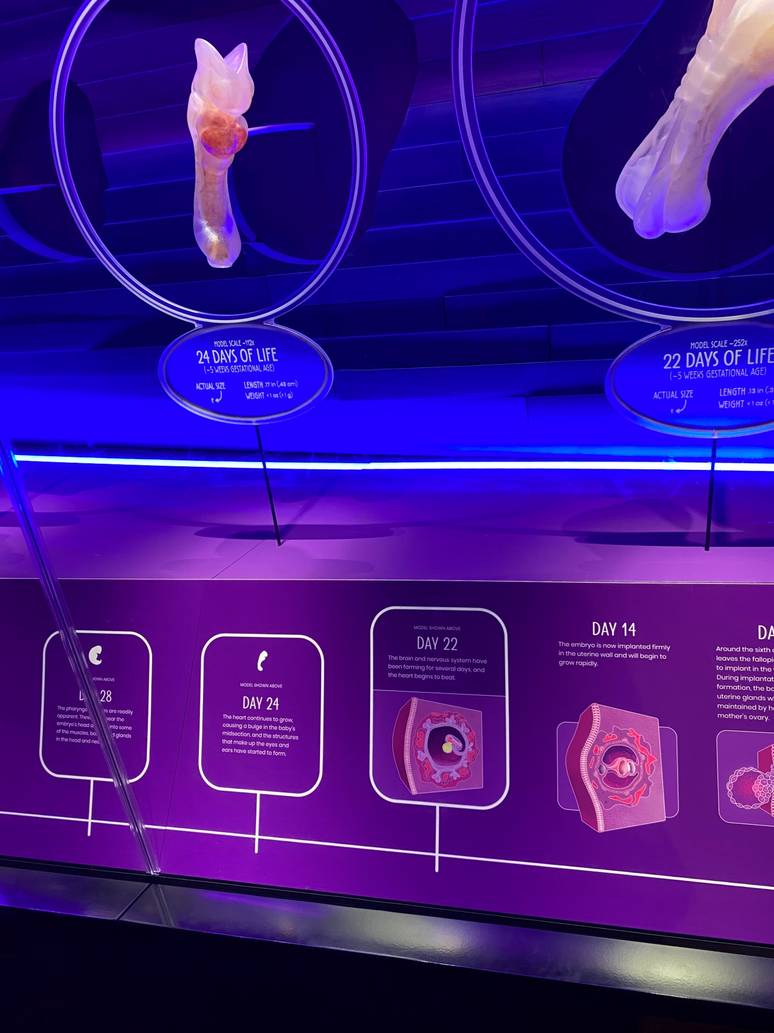

Slide 18
What that picture says
Day 22-The brain and nervous system have been forming for several days and the heart begins to beat.
Day 24-The heart continues to grow, causing a bulge in the baby’s midsection, and the structures that make up the eyes and ears have started to form.
Day 40-The eyes and ears continue forming and the hands, arms, feet, and legs are easily discerned.
By Week 5, the beating heart can be seen on ultrasound.
By Week 8, genitalia start forming and within a week, the baby will be recognizable as a little boy or little girl.

Slide 19
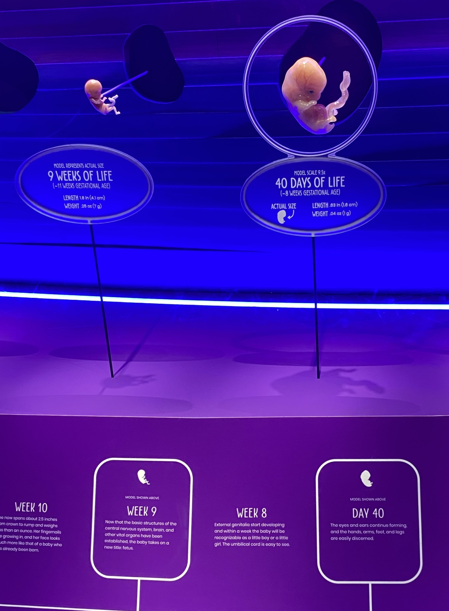

Slide 20
Now why does this matter that we believe God gives life at conception and medically this is confirmed?
It is because when God gives a life, it is his alone to take in death.
The stance of our Synod
“as persons, the unborn stand under the full protection of God’s own prohibition against murder.”

Slide 21
Now I want to address a question from last week. Can the child be considered alive medically?
This is from an abstract from an article entitled, “The Scientific Consensus on When a Human's Life Begins” published in 2021 in the journal “Issues in Law and Medicine.” It says, “Biologists from 1,058 academic institutions around the world assessed survey items on when a human's life begins and, overall, 96% (5337 out of 5577) affirmed the fertilization view.” They held the view that life begins at fertilization.

Slide 22
What about Biblically? Scripture is clear our life is in the blood.
^{ESV} Genesis 9:4 But you shall not eat flesh with its life, that is, its blood.
The Hebrew word for life is the word used in Genesis 2:7, pronounced nephesh. It is what God breathed into the body he made out of the dust of the earth. Its life is its blood. Where our DNA is found.
We see this in many places of the Bible.

Slide 23
Other places
^{ESV} Leviticus 17:10 "If any one of the house of Israel or of the strangers who sojourn among them eats any blood, I will set my face against that person who eats blood and will cut him off from among his people. ¹¹ For the life of the flesh is in the blood, and I have given it for you on the altar to make atonement for your souls, for it is the blood that makes atonement by the life. ¹² Therefore I have said to the people of Israel, No person among you shall eat blood, neither shall any stranger who sojourns among you eat blood.

Slide 24
^{ESV} Leviticus 17:14 For the life of every creature is its blood: its blood is its life. Therefore I have said to the people of Israel, You shall not eat the blood of any creature, for the life of every creature is its blood. Whoever eats it shall be cut off.

Slide 25
Therefore, Biblically our life is found in the blood. Now does a fetus produce its own blood once the heart is developed? Yes.

Slide 26
This is an excerpt found on a website talking about the role of the placenta in a woman.
Taken from a website from a hospital in California named “Cedars Sinai”-https://www.cedars-sinai.org/
“Separate Circulation. One of the placenta’s main functions is to serve as the interface between the mother's and fetus's bloodstreams. Nutrients and oxygen from the mother's blood pass into the baby's bloodstream through the placenta. Meanwhile, the baby excretes carbon dioxide and waste products through the umbilical blood vessels. But the blood of the fetus and the blood of the mother never meet. The placenta handles the exchange.” In other words, the fetus already has its own blood in the womb.

Slide 27
This is taken from the St. Louis Children’s Hospital Website.
“The heart and circulatory system of a fetus begin to form soon after conception. By the end of the fifth week, the heart of the fetus is able to pump blood throughout its body. However, since the lungs will not function until birth when the newborn takes its first breath, the mother must supply the fetus with oxygen-rich blood.”
It is being kept alive by the mother, but the mother is providing the means for the babies own heart and blood to circulate in its body.

Slide 28
Therefore, because we consider that baby alive both Biblically and medically, we believe God’s prohibition regarding taking another’s life applies. Here is where the Bible speaks to this.

Slide 29
Verses cited
^{ESV} Genesis 9:6 "Whoever sheds the blood of man, by man shall his blood be shed, for God made man in his own image.
^{ESV} Numbers 35:33 You shall not pollute the land in which you live, for blood pollutes the land, and no atonement can be made for the land for the blood that is shed in it, except by the blood of the one who shed it.
^{ESV} I John 3:15-

Slide 30
^{ESV} Acts 7:19 He dealt shrewdly with our race and forced our fathers to expose their infants, so that they would not be kept alive. (Talking about the murder of the Hebrew boys under Pharaoh).
I would add these as well
^{ESV} Luke 18:15 Now they were bringing even infants (Brephos) to him that he might touch them. And when the disciples saw it, they rebuked them. ¹⁶ But Jesus called them to him, saying, "Let the children come to me, and do not hinder them, for to such belongs the kingdom of God. ¹⁷ Truly, I say to you, whoever does not receive the kingdom of God like a child shall not enter it."

Slide 31
^{ESV} Matthew 18:6 but whoever causes one of these little ones (microns) who believe in me to sin, it would be better for him to have a great millstone fastened around his neck and to be drowned in the depth of the sea.
^{ESV} Matthew 21:15 But when the chief priests and the scribes saw the wonderful things that he did, and the children (paidos) crying out in the temple, "Hosanna to the Son of David!" they were indignant, ¹⁶ and they said to him, "Do you hear what these are saying?" And Jesus said to them, "Yes; have you never read, "' Out of the mouth of infants (Naipios) and nursing babies (thailazo) literally the ones who are nursing) you have prepared praise'?"

Slide 32
^{ESV} Matthew 18:10 "See that you do not despise one of these little ones (microns). For I tell you that in heaven their angels always see the face of my Father who is in heaven.”
^{ESV} 2 Samuel 12:23 But now he is dead. Why should I fast? Can I bring him back again? I shall go to him, but he will not return to me.“
(David referring to his child that died from its adulterous conception through him and Bathsheba).

Slide 33
Exodus 20:13-“You shall not murder”
^{ESV} Leviticus 20:1 The LORD spoke to Moses, saying, ² "Say to the people of Israel, Any one of the people of Israel or of the strangers who sojourn in Israel who gives any of his children to Molech shall surely be put to death. The people of the land shall stone him with stones. ³ I myself will set my face against that man and will cut him off from among his people, because he has given one of his children to Molech, to make my sanctuary unclean and to profane my holy name.

Slide 34
^{ESV} Exodus 21:22 "When men strive together and hit a pregnant woman, so that her children come out, but there is no harm, the one who hit her shall surely be fined, as the woman's husband shall impose on him, and he shall pay as the judges determine. ²³ But if there is harm, then you shall pay life for life, ²⁴ eye for eye, tooth for tooth, hand for hand, foot for foot, ²⁵ burn for burn, wound for wound, stripe for stripe.

Slide 35
God is clear we are not to take a life and even if we were to unintentionally kill another, there are consequences because each life is precious to Him, even the life of unborn babies.

Slide 36
The difficult questions
What about if the life of mother is in danger?
Refer to Resolution 2-39-1971
Refer to Resolution 3-02A-1979-#1
We account for that. Sometimes very hard choices have to be made.

Slide 37
What about rape and incest?
This is the real difficult question.
What you are about to hear will be controversial and you may not agree with it, but please try to understand where we are coming from Biblically on this.

Slide 38
The following statements come from The Report of the Commission on Theology and Church Relations of the LCMS wrote on the subject in 1984

Slide 39
“Very difficult and painful situations arise in cases of pregnancies which result from rape and incest. Even if such wrongful acts do not result in pregnancy, the most sensitive kind of pastoral counseling is required. Christian love manifests itself in deep compassion for those who are the unwilling victims of exploitation and violation. Guilt, fear, anger, hatred, self-loathing, and other emotional and spiritual upheavals must be dealt with wisely and mercifully. Although conception almost never occurs as a result of forcible intercourse, when it does, the life of the new human being is as valuable and as worthy of protection as any other newly begun life.”

Slide 40
“Thus, the evil and violent circumstances in which a child is conceived do not in and of themselves constitute valid grounds for recommending or approving an abortion. There is a necessity for a concentrated and sustained ministry to the woman who finds herself in such tragic circumstances. There must be concern for her physical, spiritual, and emotional needs as well as for the life and future of the child. Comfort can be taken from St. Paul’s exhortation that God promises to bring good out of even the greatest evils that befall us (Romans 8:28).”-p.35-36

Slide 41
The difficulty of this question is it would be hard to blame a woman who experienced this if she did not want to keep the baby and abort it and some of you may believe it is morally right to allow the woman this concession. I myself would have a hard time blaming a woman for making such a decision, however, the point of that statement is that if it is in fact a life, which we believe it is, then those Biblical statements would apply to this situation too. It is why the statement says,

Slide 42
“Although conception almost never occurs as a result of forcible intercourse, when it does, the life of the new human being is as valuable and as worthy of protection as any other newly begun life. Thus, the evil and violent circumstances in which a child is conceived do not in and of themselves constitute valid grounds for recommending or approving an abortion.”
In other words, we believe it would not be right to counsel a woman to abort a baby just because of the nature in which it was conceived. It is because it is still a life, no matter how you look at it. A life God gave (albeit through a sinful and egregious act). Therefore, it still falls under the protections of God’s Word.

Slide 43
What about that statement about pregnancies being rare in instances of rape? From the book “ProLife Answers to ProChoice Arguments”
“Studies conducted by Planned Parenthood’s Guttmacher Institute indicate that two consenting and fertile adults have only a 3 percent chance of pregnancy from an act of intercourse. They also indicate that there are factors involved in a rape that further reduce the chance that rape victims will become pregnant.”

Slide 44
“The Guttmacher Institute says that 14,000 abortions per year are due to rape or incest, which amounts to just over 1 percent of all abortions. Other studies show that pregnancies due to rape are much rarer than is generally thought, perhaps as few as 1 in 1,000 cases. Furthermore, since conception doesn’t occur immediately after intercourse, pregnancy can be prevented in nearly all rape cases by medical treatment that removes the semen before an ovum can be fertilized.”

Slide 45
We know that at least 1-5% of sexual assaults results in pregnancy.³ -From the National Alliance to End Sexual Violence website-from a 1996 study.
Now regardless, this is a terrible transgression against someone, showing the fallen nature of this world, which God would deplore. We should do everything we can to support and nurture a woman in this instance as Christ’s church called to compassion and mercy.

Slide 46
Now it should be clearly stated. Is there forgiveness in Christ and before God for those who have taken another life in any way?
The unforgivable sin in Scripture is to blaspheme the Holy Spirit, which would be rejecting Christ and His grace (Matthew 12:31). No sin is beyond Jesus’ forgiveness except this one.
Examples of people who took lives who were forgiven by the Lord/Jesus-Cain (marked so he couldn’t be harmed), Moses, the apostle Paul, King David (Uriah), King Ahab (I Kings 21:25-29), Ninevites (Book of Jonah).

Slide 47
It is why our Synod has taken great pains to emphasize the spiritual care of women in these instances. Read the rest of the sheet under Comments.

Slide 48
Now what are the laws of Wisconsin regarding abortion? It is allowed with restrictions
“Wisconsin State law requires that a woman meet with a counselor and physician before she can have an abortion. In Wisconsin, abortions can not be performed after 21 weeks of pregnancy.
After this counseling appointment, the woman must wait at least 24 hours before she can return for the abortion procedure. Young women under the age of 18 are required to have an adult relative (over the age of 25) with them.”
https://affiliatedmedicalservices.com/law.html

Slide 49
Is abortion legal in Wisconsin?
Wisconsin bans abortion after 21 weeks, 6 days of pregnancy and has some other restrictions on abortion access. To figure out how far along you are in pregnancy, count from the first day of your last period.
Officials in Wisconsin may start enforcing an old law that bans abortion completely.
https://www.abortionfinder.org/abortion-guides-by-state/abortion-in-wisconsin

Slide 50
From that same website.
“Wisconsin bans abortion after 21 weeks, 6 days; however many providers stop offering abortion earlier in pregnancy.
If you are under the age of 18, a parent or legal guardian must give you permission to get an abortion in Wisconsin. If getting the permission of a parent or guardian is not an option for you, you can seek a judicial bypass. A judicial bypass allows you to waive the requirement for parental involvement. If you're a minor who would like help navigating the judicial bypass process, contact the If/When/How Judicial Bypass (JB) Helpline. To contact the JB Helpline, call 844-868-2812 or submit a request online.”

Slide 51
Therefore, in summary
Scripture is clear we are formed and made by God and alive from conception.
Medically, we can see how early there is evidence of this life.
Since it is a life, it is not ours to take because it was a life given by God. We are created in His image.
It is a sin then to take another life unless it is in the name of defense or country.
Particularly, it is sin because those children belong to Christ and His kingdom is for them too.
However, if true repentance exists, there is forgiveness for the choice of abortion in Christ.

