Slide 1
“The Great Deep Burst Forth”

Slide 2
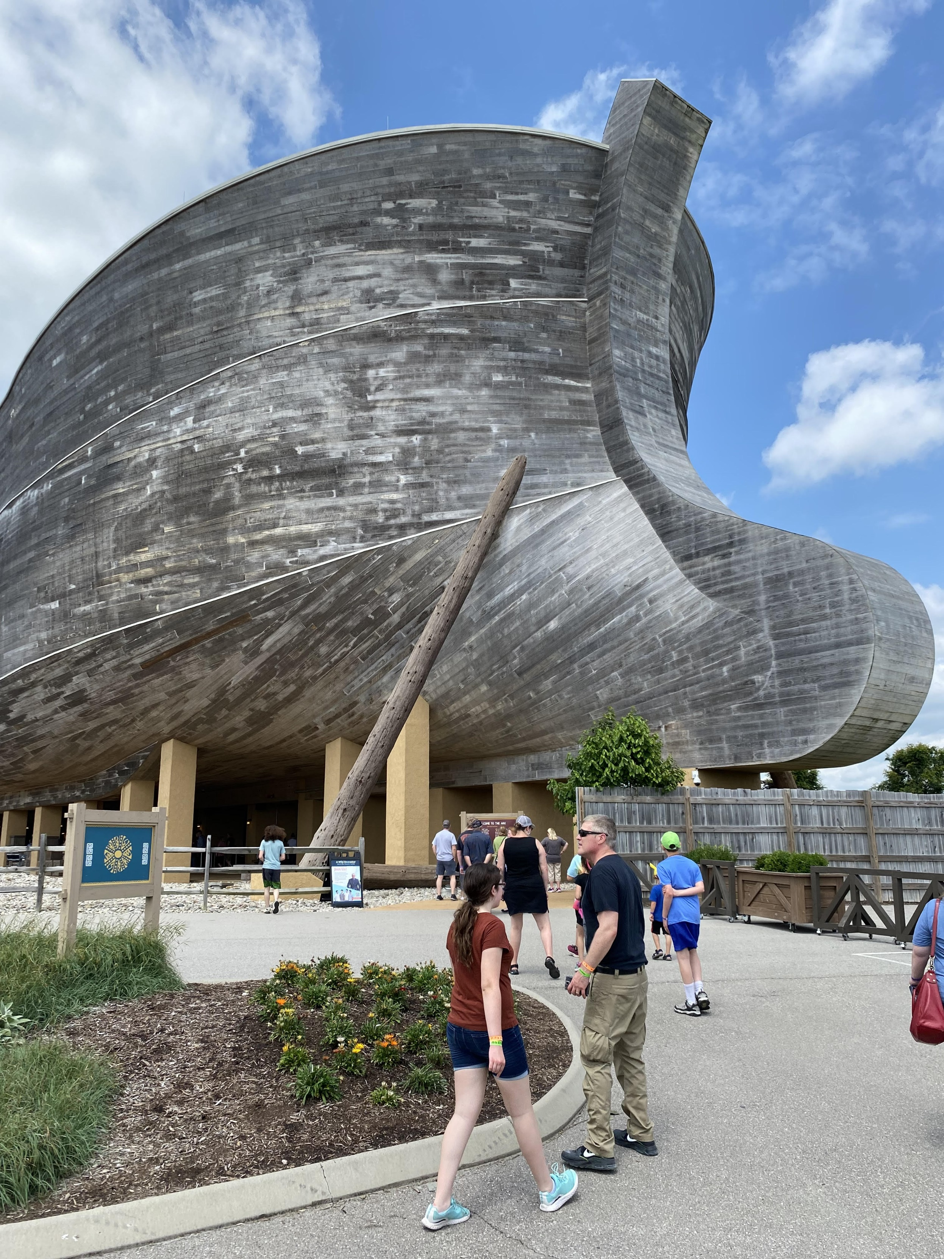
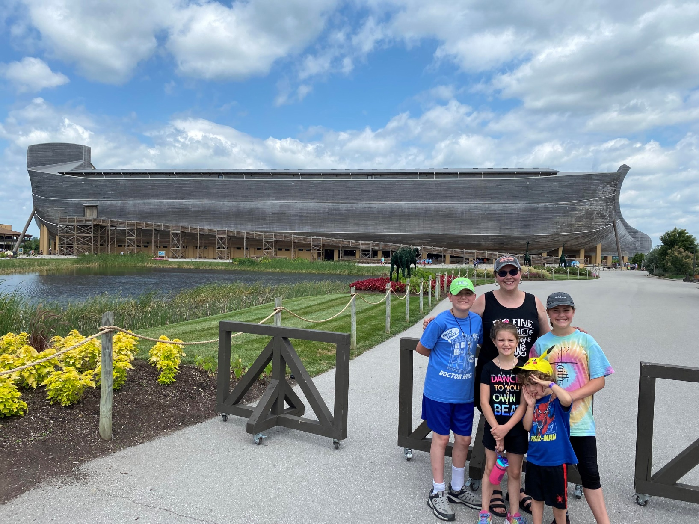
Why this Study?

Slide 3
What can I bring to this study and what can’t I bring to this study?
What I can bring is a study of the Hebrew of Genesis and the Flood account.
What I can bring is what I have studied regarding the evidence that exists for a world-wide flood that supports the Biblical account.
What I can’t bring is a deep knowledge of some of the science behind this information. Therefore, please forgive me if I misrepresent any of the information from lack of knowledge. However, I have tried my best to bring you the facts I have found in my study.

Slide 4
First of all, what is the part of Scripture we are going to focus on tonight. It is Genesis 7:11-12.
It says in the ESV translation, “In the six hundredth year of Noah’s life, in the second month, on the seventeenth day of the month, on that day all the fountains of the great deep burst forth, and the windows of the heavens were opened. And rain fell upon the earth forty days and forty nights.”

Slide 5
What could this be referring to?
First of all, the Hebrew word for fountains can also be translated springs. It is often translated this way in the Old Testament
^{ESV} Leviticus 11:36 Nevertheless, a spring or a cistern holding water shall be clean, but whoever touches a carcass in them shall be unclean.
(Referring to unclean animals falling dead into a spring or body of water and people becoming unclean by touching a carcass in that water).
^{ESV} Joshua 18:15 And the southern side begins at the outskirts of Kiriath-jearim. And the boundary goes from there to Ephron, to the spring of the waters of Nephtoah.
(spring-source of the waters from underground that leads to a river or stream or pond).

Slide 6
^{ESV} 2 Kings 3:19 “and you shall attack every fortified city and every choice city, and shall fell every good tree and stop up all springs of water and ruin every good piece of land with stones.”
(Elisha’s instructions for Israel to defeat Moab).
^{ESV} 2 Chronicles 32:4 “A great many people were gathered, and they stopped all the springs and the brook that flowed through the land, saying, "Why should the kings of Assyria come and find much water?” (Instructions of King Hezekiah as Assyria attacked).
^{ESV} Psalm 74:15 You split open springs and brooks; you dried up ever-flowing streams.
^{ESV} Psalm 104:10 You make springs gush forth in the valleys; they flow between the hills;

Slide 7
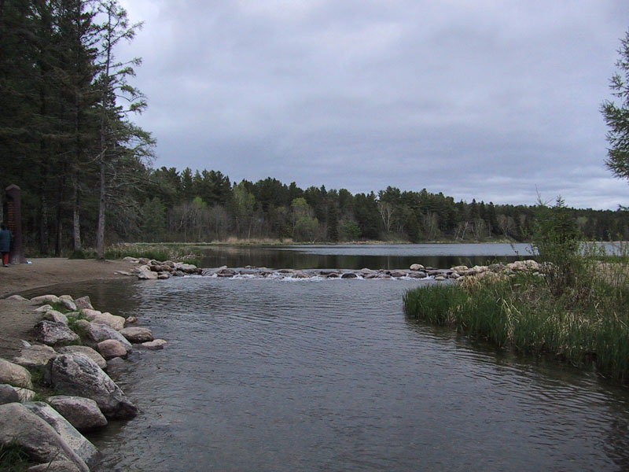
It seems to be referring to sources of water which would lead to bodies or streams of water.
Picture of Lake Itasca in Northern Minnesota-the source of the Mississippi River.

Slide 8
Of course, the actual source of the Mississippi River is the tributaries that feed Lake Itasca which then begins to flow downward. The river is also fed by other underground springs.
“Groundwater springs are present throughout much of the river channel throughout this watershed. These springs are especially common above Lake Bemidji where groundwater contributes approximately two-thirds of the Mississippi River’s flow in this section.”-
This is taken from the Minnesota Pollution Control Agency website-https://www.pca.state.mn.us/watershed-information/mississippi-river-headwaters

Slide 9
Picture from Governor Dodge State Park here in Wisconsin

Slide 10
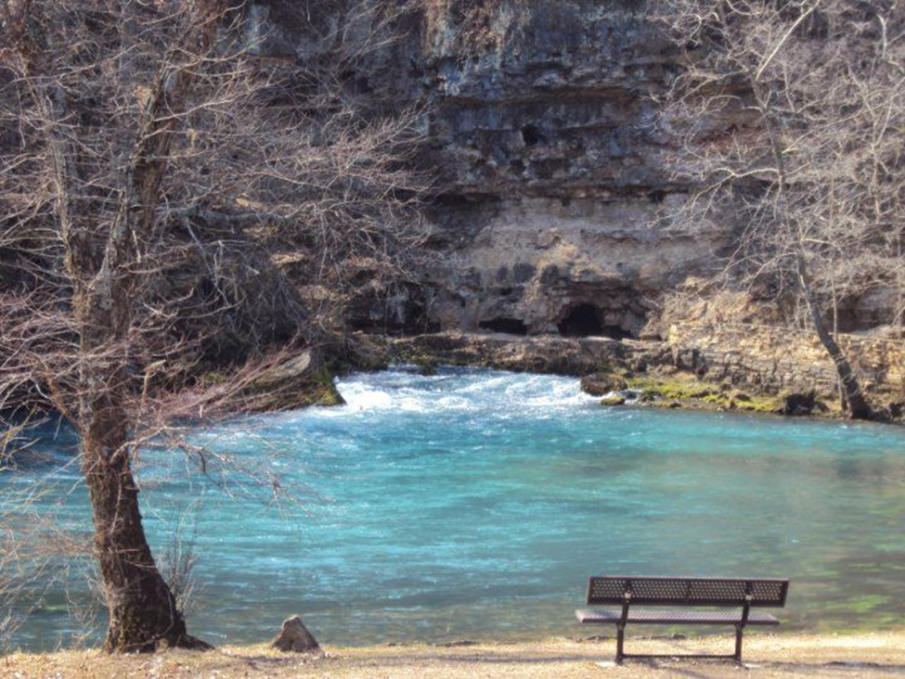
278 million gallons/day
Big Spring: Located near Van Buren, Missouri in Ozark National Scenic Riverways' Big Spring Campground, this is the largest spring in the state, and one of the largest in the world. On an average day, some 278 million gallons of water gush forth from subterranean passages, swelling the nearby Current River.

Slide 11
Therefore, the fountains or springs of the great deep burst forth.
Now what is the great deep referring to?
Of the great deep-Hebrew word first used in Genesis 1:2. “The earth was without form and void, and darkness was over the face of the deep.”
Moses uses this word to describe where the Egyptian army was swept down to in the Red Sea-Ex. 15:5, 8.
Job describes the deep of the sea-in Job 38:16;
Psalm 33:7 talks about the deep-seems to be associated with the seas. Also Psalm 104:6, 106:9, 135:6, 148:7.

Slide 12
Quote from the Genesis Commentary written by Gordan J. Wenham,
“’deep’, ‘deep waters’ occurs 36 times in the OT. Its basic meaning, ‘deep water’ is found in many passages. ‘Deep water’ can threaten life in that a man may drown in it (Exodus 15:8), but it can also assure the continuance of life in the dry climate of the Near East (Gen. 49:25, Deut. 8:7). In a small number of passages, including this one, it is identified with the primeval ocean that is supposed to surround and underlie the earth (Gen. 7:11).”-p. 16
Does this underlying ocean exist? Yes, in a sense.

Slide 13
Do you know 30% of the world’s fresh water is found underground in deep reservoirs or aquafers.
“This entry lists the major (mega) aquifer system(s) that underlie a country, keeping in mind that many of these mega aquifers are so large that they extend under multiple countries. More than 30% of freshwater is held in underground aquifers. There is great variation in the size of such aquifers, but a limited number of very large aquifer systems contain a majority of the world’s groundwater volume in storage.”-
Quote from the website cia.gov/. Website hosted by the Central Intelligence Agency of the United States

Slide 14
Taken from a National Geographic Article about the Water Wars in the world.

Slide 15
“Statistics from the United Nations indicate that the total volume of freshwater on the earth is around 35 million cubic kilometres; 30 percent is stored underground and potentially available for human consumption.”-taken from the website https://www.connectedwaters.unsw.edu.au/articles/2011/04/walking-water

Slide 16
From that same website
“There are 37 great aquifer systems of the world (4). These 37 largest aquifers jointly cover almost 35 million square kilometres - equivalent to just under a quarter of the entire land surface.”

Slide 18
It seems to describe a splitting or rupturing of the great deep, causing the springs in that great deep to erupt causing earthquakes and volcanoes.
The following pictures are from the Signs located at the Ark Encounter. Show book. Then, pgs. 60-63

Slide 19
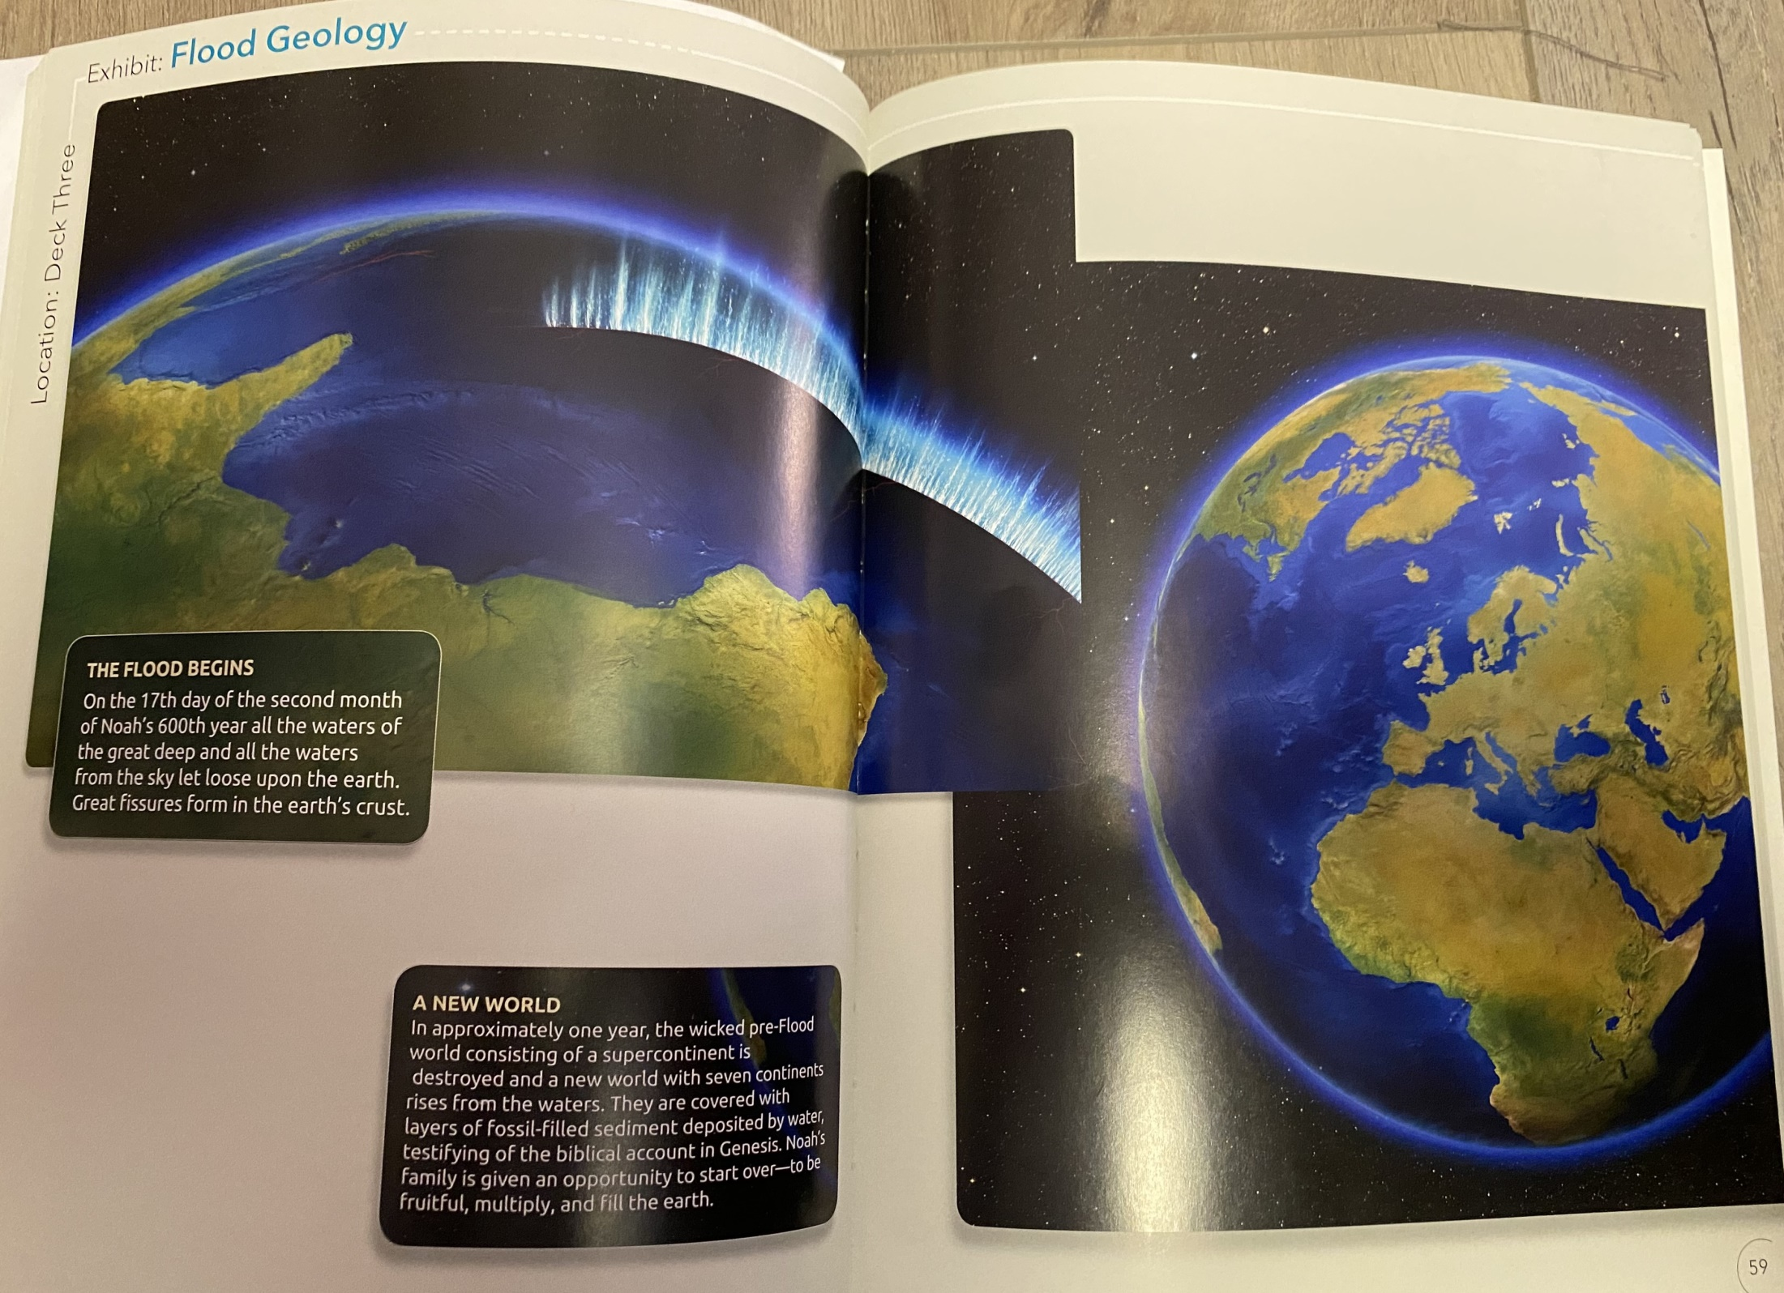

Slide 20
The sign reads: A new world
“In approximately one year, the wicked pre-Flood world consisting of a supercontinent is destroyed and a new world with seven continents rises from the waters. They are covered with layers of fossil-filled sediment deposited by water, testifying of the biblical account of Genesis.”

Slide 21
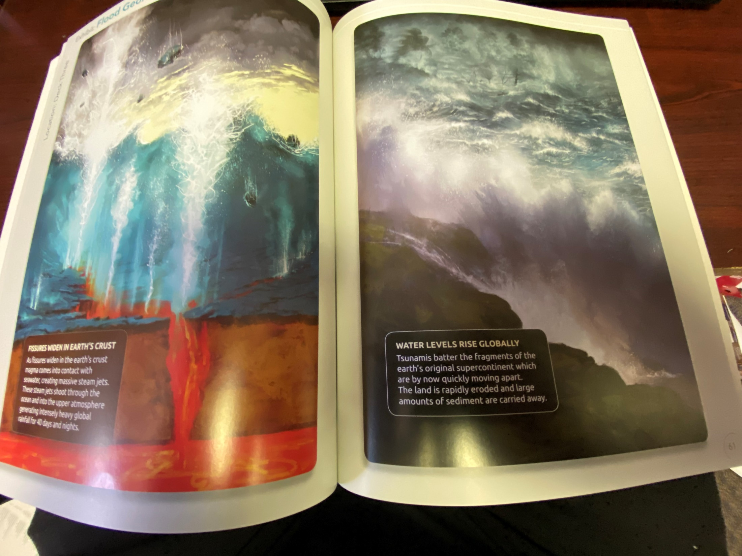

Slide 22
That sign reads-“As fissures widen in the earth’s crust, magma comes into contact with seawater, creating massive steam jets. These steam jets shoot through the ocean and into the upper atmosphere generating intensively heavy global rainfall for 40 days and nights.” I think it is safe to say it definitely contributed.

Slide 23
Now my family saw what this might look like on a small scale a few years ago. Have you ever been to Yellowstone National Park?

Slide 24
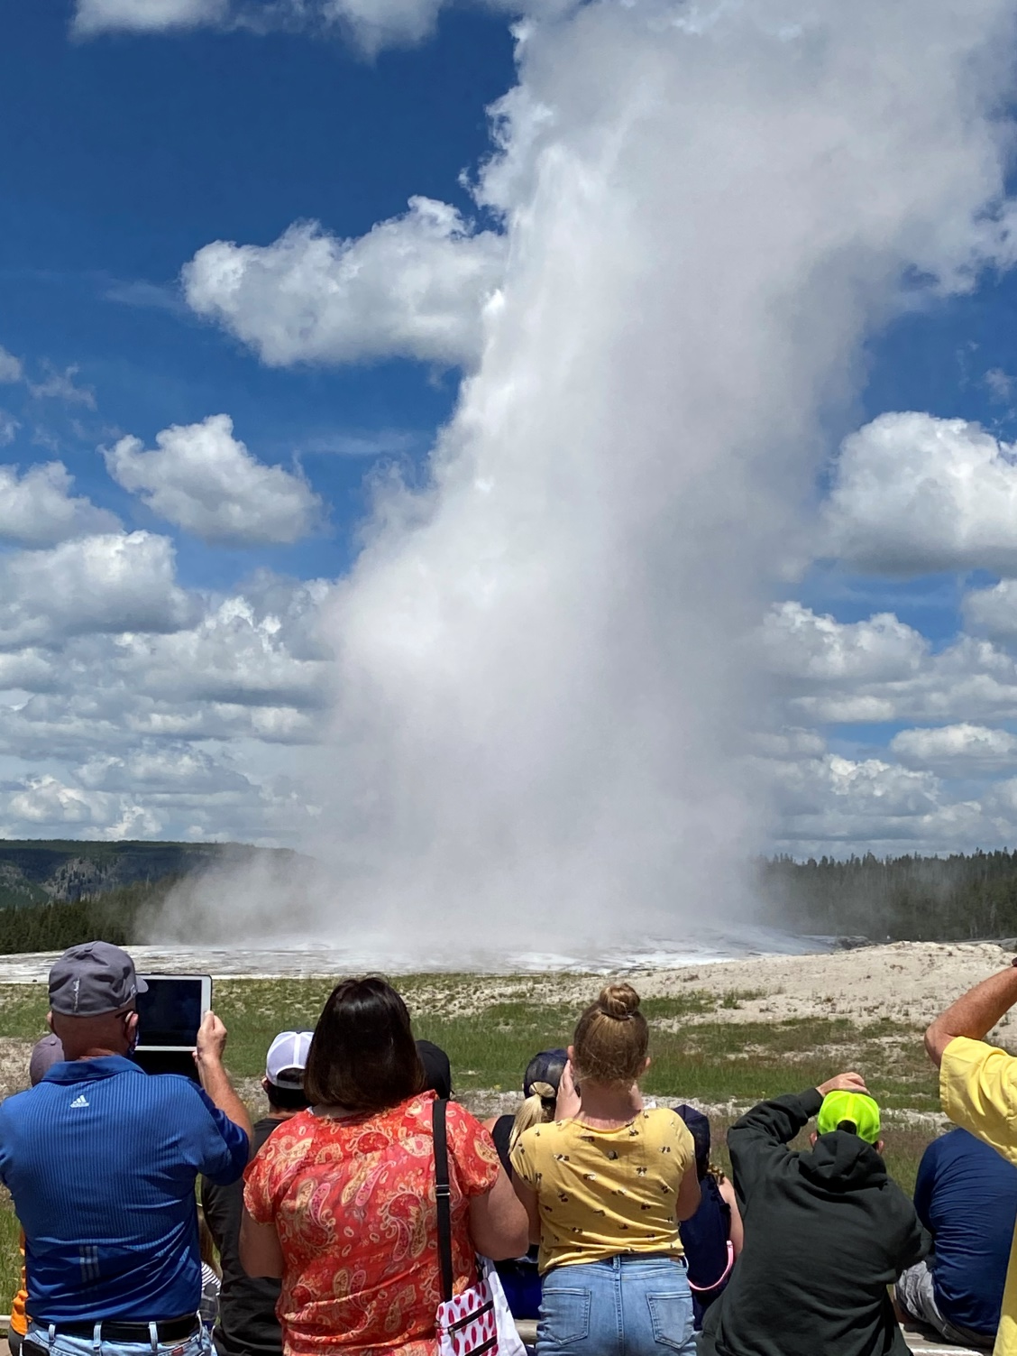
Picture of Old Faithful

Slide 25
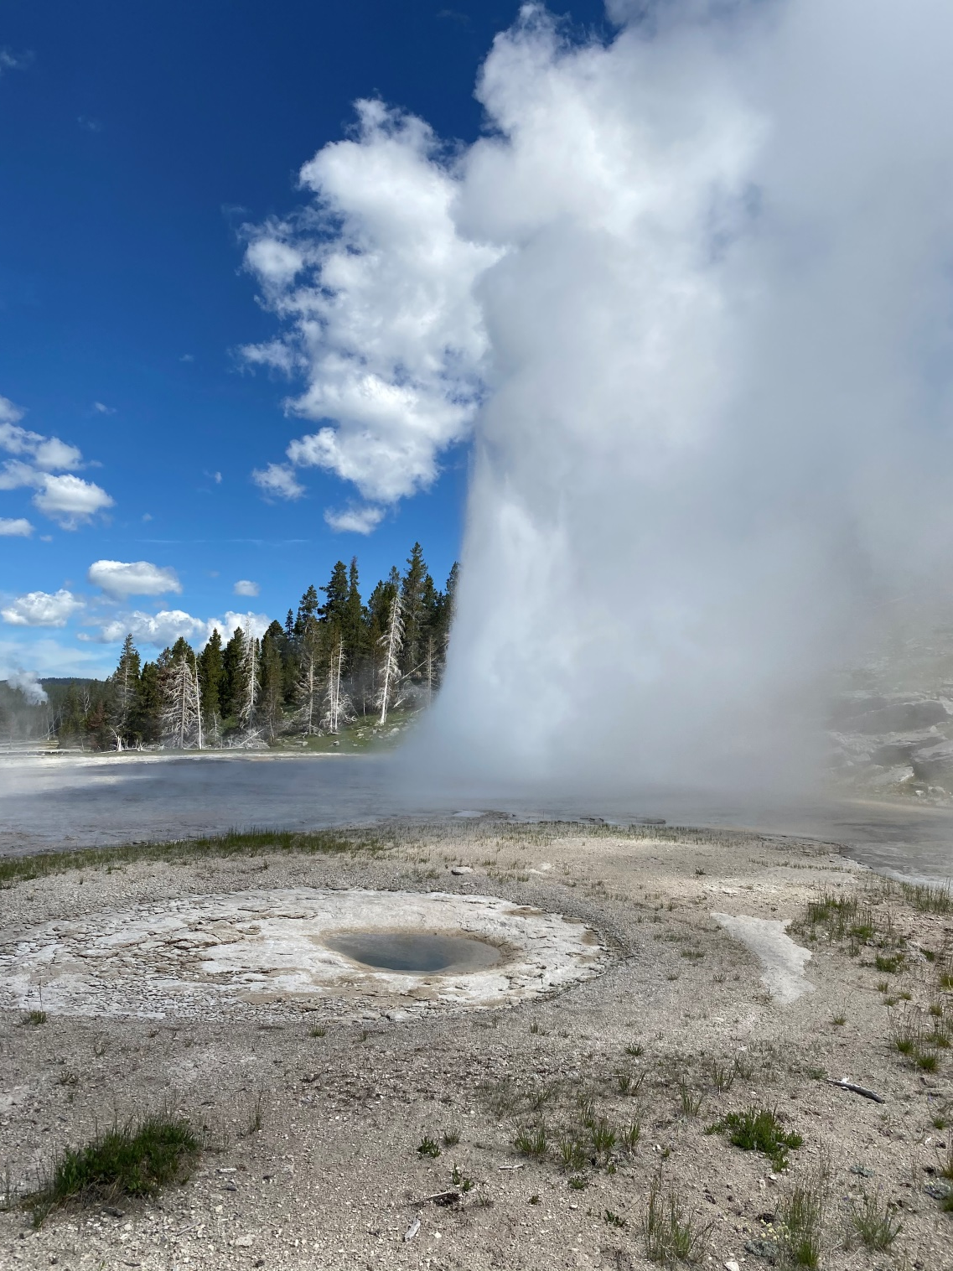
Picture of Grand Geyser

Slide 26
Now of course, on a larger scale, we know volcanoes can greatly affect the weather. The following quote is taken from the United States Geological Survey website-usgs.gov.
“Volcanoes can impact climate change. During major explosive eruptions huge amounts of volcanic gas, aerosol droplets, and ash are injected into the stratosphere. Injected ash falls rapidly from the stratosphere -- most of it is removed within several days to weeks -- and has little impact on climate change. But volcanic gases like sulfur dioxide can cause global cooling, while volcanic carbon dioxide, a greenhouse gas, has the potential to promote global warming.”

Slide 27
Examples:
“The most significant climate impacts from volcanic injections into the stratosphere come from the conversion of sulfur dioxide to sulfuric acid, which condenses rapidly in the stratosphere to form fine sulfate aerosols. The aerosols increase the reflection of radiation from the Sun back into space, cooling the Earth's lower atmosphere or troposphere.”

Slide 28
“Several eruptions during the past century have caused a decline in the average temperature at the Earth's surface of up to half a degree (Fahrenheit scale) for periods of one to three years. The climactic eruption of Mount Pinatubo on June 15, 1991, was one of the largest eruptions of the twentieth century and injected a 20-million ton (metric scale) sulfur dioxide cloud into the stratosphere at an altitude of more than 20 miles.”

Slide 29
“The Pinatubo cloud was the largest sulfur dioxide cloud ever observed in the stratosphere since the beginning of such observations by satellites in 1978. It caused what is believed to be the largest aerosol disturbance of the stratosphere in the twentieth century, though probably smaller than the disturbances from eruptions of Krakatau in 1883 and Tambora in 1815. Consequently, it was a standout in its climate impact and cooled the Earth's surface for three years following the eruption, by as much as 1.3 degrees F at the height of the impact.”

Slide 30
“The large 1783-1784 Laki fissure eruption in Iceland released a staggering amount more sulfur dioxide than Pinatubo (approximately 120-million ton vs. 20). Although the two eruptions were significantly different in length and style, the added atmospheric SO2 caused regional cooling of Europe and North America by similar amounts for similar periods of time.”-
The following slides were taken from the United States Geological Survey website-usgs.gov.

Slide 31
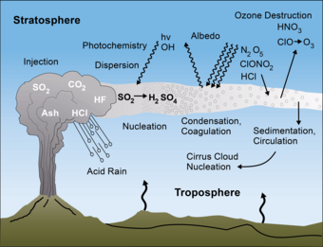
Here is a picture from their website

Slide 32
Now imagine this on a worldwide scale and what this would cause to happen all over the earth. The following article from the website Christiananswers.net speculates on this.

Slide 33
“So, the “fountains of the great deep” are probably oceanic or possibly subterranean sources of water. In the context of the flood account, it could mean both. If the fountains of the great deep were the major source of the waters, then they must have been a huge source of water. Some have suggested that when God made the dry land appear from under the waters on the third day of creation, some of the water that covered the earth became trapped underneath and within the dry land.[2] Genesis 7:11 says that on the day the flood began, there was a “breaking up” of the fountains, which implies a release of the water, possibly through large fissures in the ground or in the sea floor. The waters that had been held back burst forth with catastrophic consequences.

Slide 34
There are many volcanic rocks interspersed between the fossil layers in the rock record—layers that were obviously deposited during Noah's flood. So it is quite plausible that these fountains of the great deep involved a series of volcanic eruptions with prodigious amounts of water bursting up through the ground. It is interesting that up to 70 percent or more of what comes out of volcanoes today is water, often in the form of steam.”

Slide 35
In a book entitled, “The Flood”, which I will reference later, it says, “That active volcanoes give off vapor in quantities almost beyond comprehension is a fact established by observation. Steam equivalent to 460 million gallons of water has been observed to issue from one of the subsidiary cones of Mt. Etna within one hundred days, which would mean 4,600,000 gallons of water a day, and that only from one secondary cone of one volcano”-p. 100

Slide 36
In fact in the Answers in Genesis website, it talks about the phenomenon that is the Yellowstone area. Of course, it is considered a super-volcano. From the website
“Much of Yellowstone is positioned on the enormous craters of several volcanoes—one of them the largest in North America. Every so often, news headlines predict an eruption, warning that the ginormous mass of ash and lava would spell certain disaster for North America. The documentary Yellowstone Supervolcano: American Doomsday claims, “Yellowstone is a disaster waiting to happen with the power to change the face of the earth. . . . It will be a global catastrophe . . . and bring the world to a standstill.”

Slide 37
Continuing…“Why are there so many geysers in the Yellowstone area? It’s because much of the area, centered on Yellowstone Lake, is the cauldron-like crater (referred to as a caldera) of a humungous volcano. Known as the Yellowstone Caldera, the crater measures a staggering 43 by 28 miles (70 by 45 km). As the largest volcano on the North American continent with a history of huge explosive eruptions, no wonder the Yellowstone Caldera is called a supervolcano.

Slide 38
“But it did erupt several times in the past, with devastating consequences. Some of the thick ash deposits have been found as far away as Texas. Had anyone been living in North America back then, they would have faced dire consequences.”

Slide 39
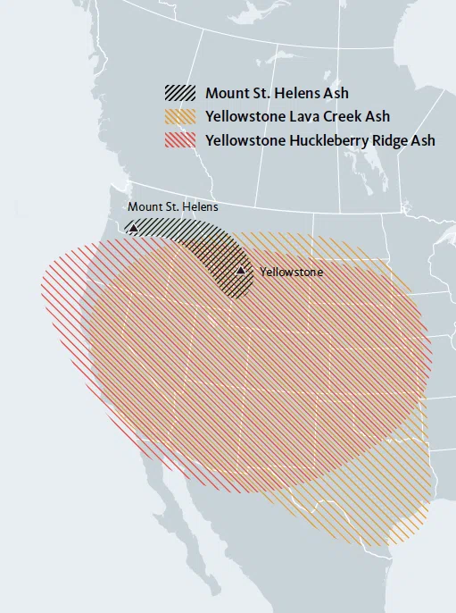
Picture of the Ash Plume remnants in the rock across the Western United States.

Slide 40
He talks about the Answers in Genesis website that there seems to be evidence for at least two major eruptions from the Yellowstone Super-volcano at some in history. Now is there evidence of volcanic eruptions happening in the past on a large scale? The answer is yes.

Slide 41
Interestingly, a new theory about the extinction of the dinosaurs seems to confirm how this would happen. Listen to excerpts from a USA Today article from November 28, 2023.
“Reigniting the debate, a recent study posited that volcanic eruptions may have already thrown the ecosystem into chaos and threatened the existence of non-bird dinosaurs before the asteroid crashing into Earth delivered the final blow. The international team of researchers are the latest experts who claim that the world the dinosaurs roamed was one teeming with critical levels of sulfur that set the stage for their extinction. Such instability would have triggered a global drop in temperatures around the world, creating conditions inhospitable to life, according to the research.”
https://www.usatoday.com/story/news/nation/2023/11/28/dinosaurs-extinction-study-asteroid-meteorite-volcanic-eruptions/71728789007/

Slide 42
Isn’t that interesting? A further part of this article.
“The team's findings were published in October in Science Advances and revealed last week in a press release.
“Our research demonstrates that climatic conditions were almost certainly unstable, with repeated volcanic winters that could have lasted decades, prior to the extinction of the dinosaurs," study co-author Don Baker, a geologist at McGill University, said in a statement. "Our work helps explain this significant extinction event that led to the rise of mammals and the evolution of our species.“
Of course, I would not agree with that statement as a Creationist, but it is interesting that this theory has now been postulated.

Slide 43
The article is found in SCIENCE ADVANCES
4 Oct 2023; Vol 9, Issue 40-
DOI: 10.1126/sciadv.adg8284
It was written by a team of scientists who were studying rock samples from the Deccan Traps as they are called in present-day India.
According to their findings, the rocks were formed by a large amount of volcanic activity in previous times. The science is definitely beyond me, but the conclusions are interesting.

Slide 44
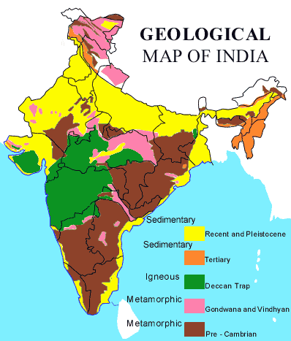

Slide 46
A quote from the study:
“Warming and cooling trends preceding the KPB (14, 15) are interpreted as a signal that degassing from Deccan Traps volcanism was already forcing the global end-Cretaceous (Maastrichtian) climate, possibly enhanced by orbitally driven insolation variations (16), and that the Chicxulub impact wreaked further havoc on previously volcanically perturbed global ecosystems (12, 17). Some have argued that Deccan volcanism alone was sufficient to induce a mass extinction and that the Chicxulub impact only served to exacerbate its consequences on the ecosystems (19). Conversely, others suggested that the greenhouse forcing of Deccan Traps degassing played a mitigating role on the impact-derived, global winter (13, 14).”

Slide 47
Another quote from the article
“The steady drop in temperature during the latest Cretaceous coincides with the emplacement of the Thakurvadi to Bushe lavas, the ones showing the highest S concentrations [maximum of ~1800-ppm S, for a total eruptive volume estimated between 86,000 and 466,000 km3 (36)]. Despite this, volcanically discharged SO2 might not have been the sole cause of the observed global cooling trend unfolding for 0.2 Ma during the latest Cretaceous. The effect of SO2 on the atmosphere cannot be linearly upscaled because of limiting factors to the conversion of SO2 to sulfate aerosols, such as water vapor in the atmosphere (75) or residence time in the stratosphere [1 to 3 years (76, 77)]. However, as modeled before (22), sulfur emissions from Deccan Traps could have had marked consequences on the global climate (up to 10 K temperature drop) if discharged through sustained, prolonged activity (magmatic fluxes of 300 to 480 km3/year) even accounting for short hiatuses between individual eruptions.”

Slide 48
The last words of the article
“Such voluminous, recurring eruptive pulses could have caused repeated global cold spells (73), with temperature drops of up to about 10 K, interspersed with rapid recovery episodes. Sulfur budgets reconstructed by this study to SO2 (4 to 10 Tg/km3) for Kalsubai and Lonavala Subgroup lavas support previous models [for reference, a value of SO2 (5 Tg/km3) was estimated by Fendley et al. (25) and Self et al. (28)], whereby early eruptions in the MDVP were sufficient to produce repeated cold shocks. The final blow on the biota was likely given by the Chicxulub impact, but our dataset indicates that volcanic-driven climate disturbance was already underway before the KPB, possibly driving a press-pulse extinction model (17). Deccan Traps volcanism set the stage for a global biotic crisis, repeatedly deteriorating environmental conditions by forcing recurring short volcanic winters during the ~0.4 Ma before the Cretaceous-Paleogene boundary.”

Slide 49
This is a lot of scientific jargon saying a large amount of volcanic activity in a previous time would have caused a significant cooling event on the earth and led to an extinction of animals. Of course, this is the theory the Ark Encounter subscribes too.

Slide 50
Now it said that the volcanic activity that caused the Deccan Traps might have caused temperatures to drop 10 Kelvin degrees which would be equivalent to an 18 degree drop in Fahrenheit. Think about this. Now the average temperature in winter for example would drop from 20 degrees to 2 degrees.
Now around the middle of the earth, it might still have been bearable and it not be completely freezing, but on the extremes, it would have been very difficult. We know the animals got off the Ark on Mt. Ararat in modern-day Turkey, but it was after a year and 11 days in the Ark. Could the influence of all that volcanic activity subsided enough by that time for things to be inhabitable again? At least in the middle of the earth.

Slide 51
Interesting, this does support other studies theorizing the same thing. In Answers in Genesis, it refers to the Volcanic Demise Hypothesis, such as what was put forth in a previous article entitled
“Volcanoes, Not Meteorite, Killed Dinosaurs, Scientist Argues,” written by Tia Ghose found in LiveScience, December 7, 2012. http://www.livescience.com/25324-volcanoes-killed-dinosaurs.html.

Slide 52
Also in a previous study on the Deccan Traps published in Science magazine in October 2015, it speculates that volcanic activity predates the asteroid hitting the earth and might have led to the extinction of the dinosaurs.

Slide 53
In the Answers in Genesis article, written by Troy Lacey on November 17, 2015, he talks about this study.
“In its October 2nd, 2015 issue, Science published a report announcing a more detailed study of the many lava flows in the Deccan Traps located in Western India. The Deccan Traps are a massive igneous province—think of it as a lava flood plain—comparable in size to the US states of Oregon and Washington combined and composed of numerous lava flow layers having a total depth of over 6,500 feet (2,000 meters). The strategy was to examine the mineral composition of the lava flows from older samples on the bottom, to younger samples near the top of this thick sequence of lava flows. According to the report, the lava flows show differences in composition, and the timing of their eruption, according to the radiometric dating methods used, coincide remarkably well with the 66-million-year-old conventional date of the Chicxulub impact (within 50,000 years). The volcanic fissures in the area are interpreted to have been active before the impact, but with much smaller eruptive events. Lava flow rates appear to have markedly increased at roughly the same time as the asteroid impact.”

Slide 54
He goes on, “First of all, it should be remembered that asteroid/meteor impacts are not foreign to Flood geology models. A meteor impact or impacts may have been the catalyst which triggered the fountains of the great deep to be broken up (Genesis 7:11). Once this occurred, the catastrophic movement of the tectonic plates which resulted from that breakup would have triggered in turn the release of huge quantities of molten rock onto the ocean floor and on land. Increased volcanism is a natural consequence of this continental breakup event, as molten rock (magma) from the upper mantle rises into the huge rifts in the crust. This volcanism associated with Catastrophic Plate Tectonics (CPT) would have been of unprecedented magnitude and worldwide extent. At the plate boundaries, the magma rapidly rising into the fissures would push the plates apart, so that their separation accelerated to meters (tens of feet) per second. The net result would have been violent volcanic eruptive events on a massive global scale.”

Slide 55
Continuing…“At the start and early stages of the Flood, as the pre-Flood seafloor spread, it would have subducted into the mantle. At the same time this was occurring, the resultant tensional stress tore apart the pre-Flood supercontinent. As the tectonic plates spread, mantle plumes produced by return convective flow would have risen through fissures in the crust, causing increased lava flows. Continued barrages by meteors during the Flood would have only exacerbated this process. Sometime after the 150th day of the Flood, the Chicxulub impact and these Deccan eruptions are likely to have occurred. This actually fits the interpretation of the analytical data in Science’s paper that the deep crustal magma chambers suddenly “enlarged” right about the time of the impact.”

Slide 56
Therefore, it is evident from geology today that there was large-scale volcanic activity and breaking up of the continents in the past.

Slide 57
Now one could ask at this point. Yea, but what about Noah and his family leaving in the ark through this.
Well, it could be the Lord erupted the great deep in places far from Noah and the ark, but the effects of this bursting forth in other parts of the world would have led to the right conditions for a global flood, especially given the fact that the “bursting forth” of the great deep wasn’t the only source of water.

Slide 58
The Biblical account does also say in Genesis 7:11, “and the windows of the heavens were opened.”
Could be translated “window or chimney”-like Hosea 13:3.
^{ESV} Hosea 13:3 Therefore they shall be like the morning mist or like the dew that goes early away, like the chaff that swirls from the threshing floor or like smoke from a window.

Slide 59
The windows of heaven are mentioned a couple other times in the OT too.
ESV Malachi 3:10 Bring the full tithes into the storehouse, that there may be food in my house. And thereby put me to the test, says the LORD of hosts, if I will not open the windows of heaven for you and pour down for you a blessing until there is no more need.
ESV Isaiah 24:18 He who flees at the sound of the terror shall fall into the pit, and he who climbs out of the pit shall be caught in the snare. For the windows of heaven are opened, and the foundations of the earth tremble.

Slide 60
What does “the heavens” mean? Well, Genesis 1:6-8 says that God said, “Let there be an expanse in the midst of the waters. And made the expanse and separated the waters that were above the expanse from the waters that were above the expanse. And it was so. And God called the expanse Heaven.”
Therefore, the windows of the heavens would be the windows of this expanse.
According to the commentator Wenham, “Put another way, the firmament (expanse) occupies the space between the earth’s surface and the clouds. Quite how the OT conceives the nature of the firmament is less clear.”-p. 19

Slide 61
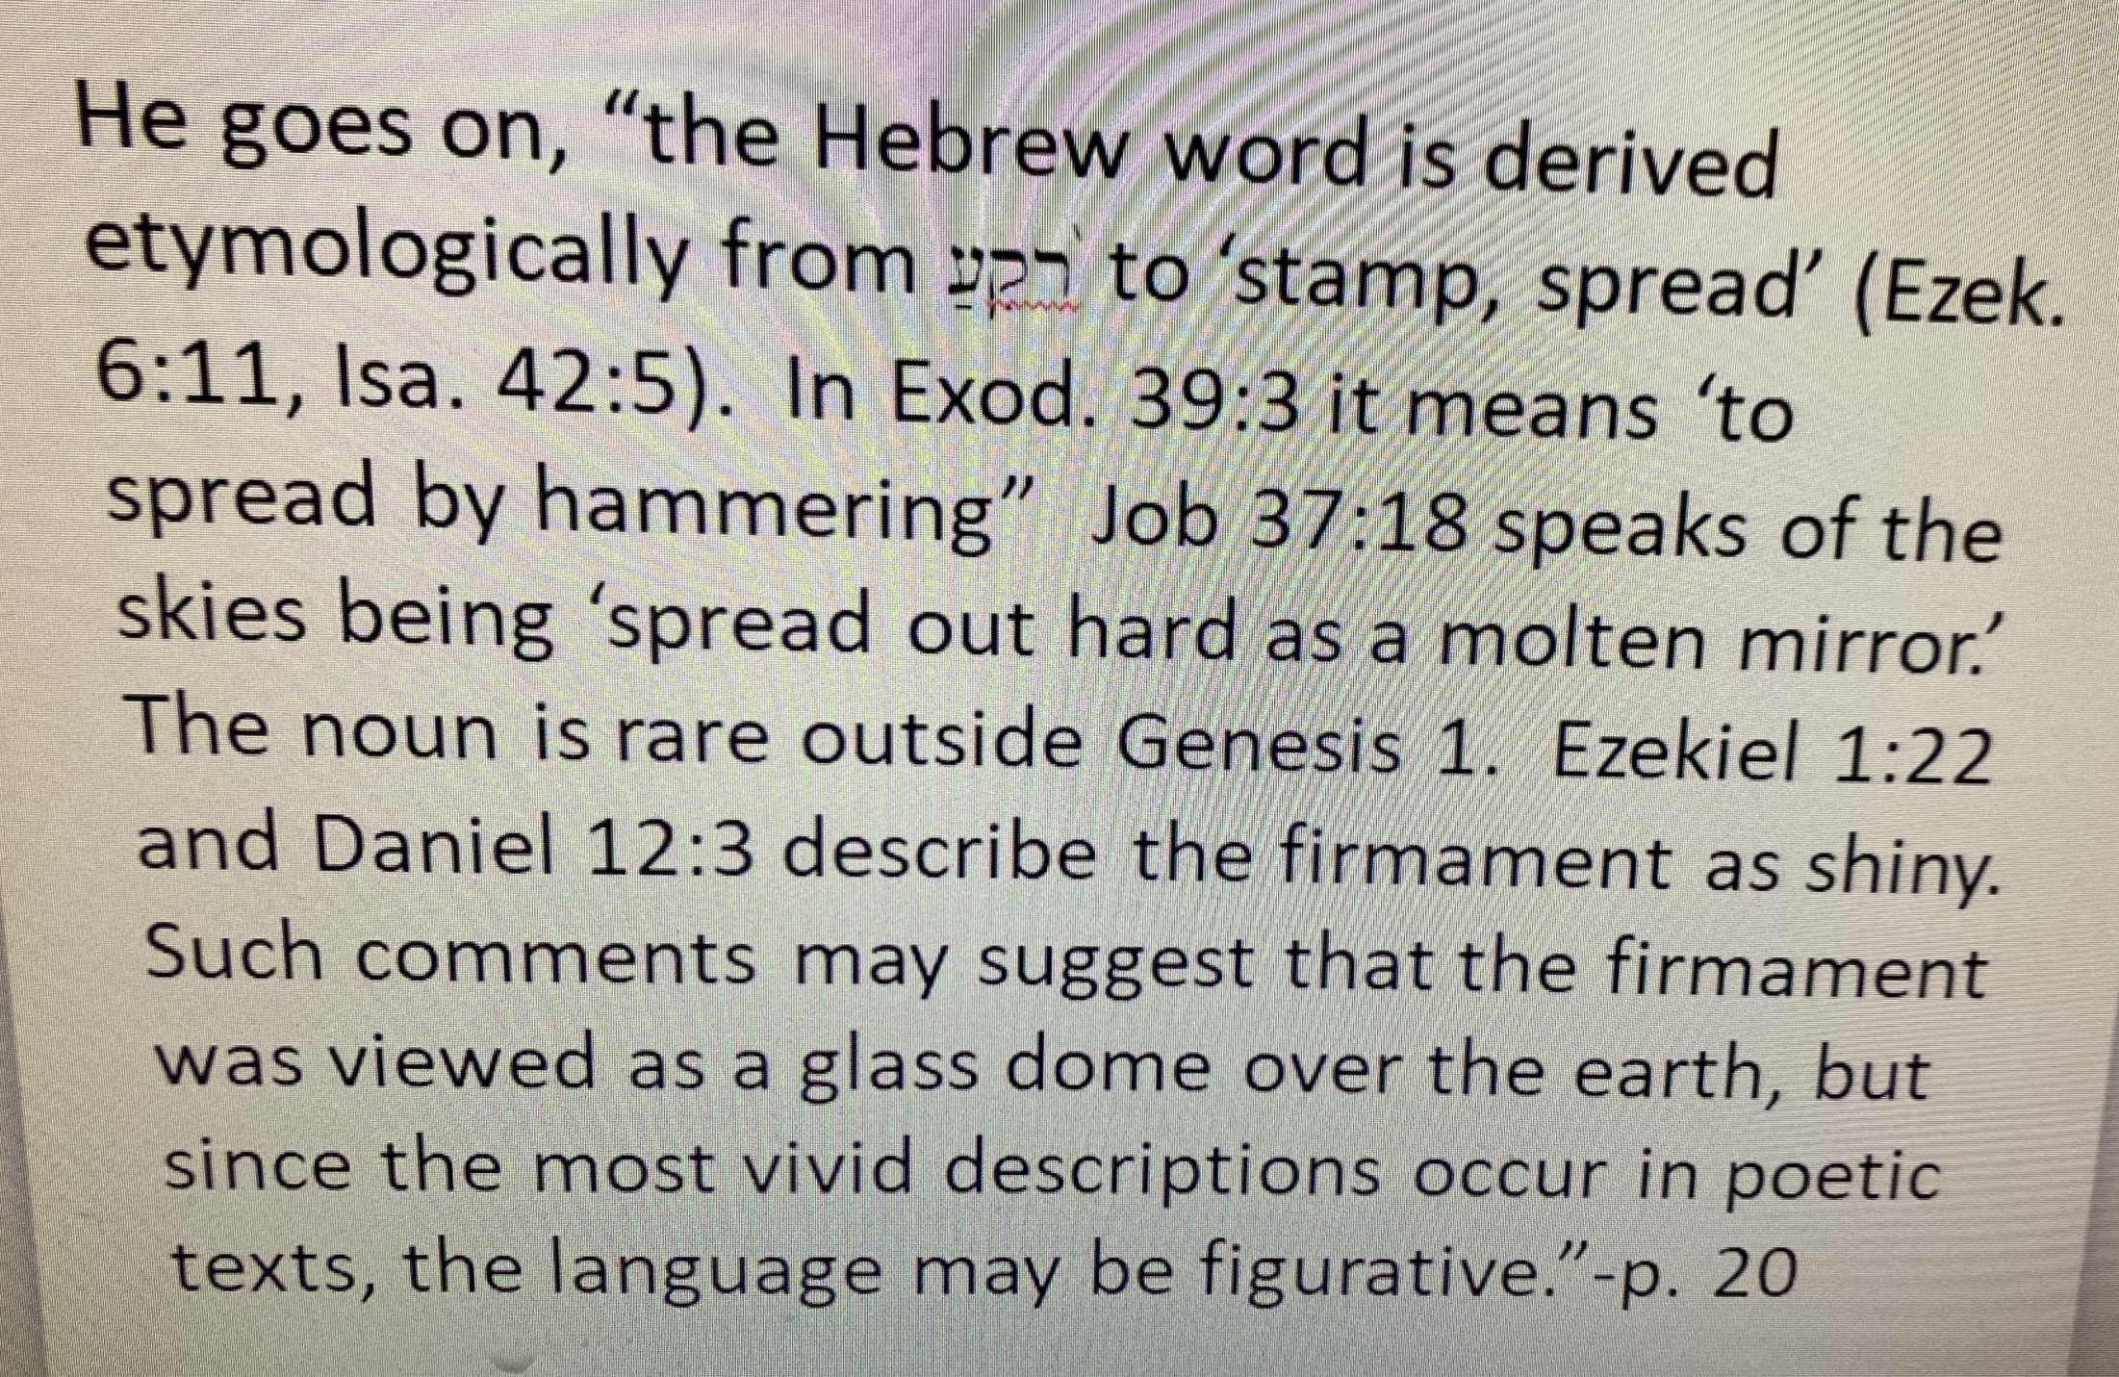

Slide 63
Therefore, the Lord opened up “the windows” of that expanse called Heaven, perhaps like a canopy over the earth and water also came down from above.
Now just think about a really hard 2 to 4 inch rain and how much damage and moving can be caused by that. Then multiply that by thousands of inches over 40 days and nights. We cannot grasp the amount of upheaval and changing this would cause to the landscape of our world with both the climate effects from the bursting forth and the unleashing of the expanse.

Slide 64
Now what other evidence do we see in the world of this “bursting forth” and what it might have caused or further evidence for a world-wide flood
Around the world, there is evidence of what geologists call, ‘rubble drift and ossiferous fissures.’

Slide 65
In a book entitled, “The Flood” published in 1951 written by Alfred Rehwinkel, there was already evidence pointing to a world-wide flood that had been uncovered. He says, “By ‘rubble drift’ is meant a certain type of deposit or sediment consisting of massive, angular unrolled material tumultuously deposited in local pockets and catchment areas, generally full of shattered bones. And by ‘ossiferous fissures’ are meant great fissures or rents in the earth which were formed by some violent contortion of the surface of the earth.”-p. 179

Slide 66
Here is a picture of a fissure that developed in Southern Pinal County, Arizona
On January 23, 2017 the Arizona Geological Survey (AZGS) posted a YouTube video from an aerial drone showing a large, newly discovered earth fissure.

Slide 67
Now we know fissures created by earthquakes can be massive. In the Flood book, it says, “In the year 1783, a great earthquake occurred in Calabria which caused fissures to be opened 500 feet wide and a thousand feet long.”-p. 103
He then gives many such examples from ancient earthquakes.

Slide 68
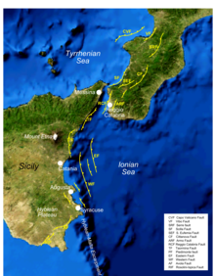

Slide 70
He then goes on to give many examples. He says, “A large deposit of bones in a cavity of the calcerous beds of the steppes of Russia was discovered in 1847 near Odessa. In this cavity were found 4,500 bones of bears derived from at least one hundred individual animals, with these were found remains of species of the cat family, hyenas, horses, boars, mammoth, rhinoceros, and deer, together with remains of numerous insectivores and rodents, such as hares, otters, martens, as well as wolves and foxes.”-p. 181.

Slide 71
He gives examples of these kinds of deposits in France, Greece, Germany, England, and Italy.
In fact, he cites one such deposit found in the northwest corner of Nebraska. He says, “This bone bed was accidentally discovered in 1876. It contains the bones of rhinoceroses, camels, giant wild boars, and other animals, buried together in a confused mass as only water would deposit them. It is estimated that the bones of about nine thousand complete animals are buried on this one hill.”-p. 183.

Slide 72
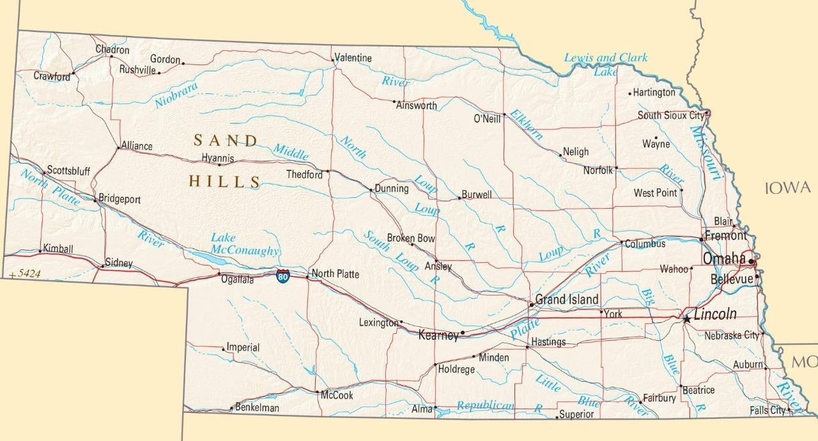
I am not sure which site in particular he is referring to, but in the Northwest part of Nebraska there is what is called the “Agate Fossil Beds.”

Slide 74
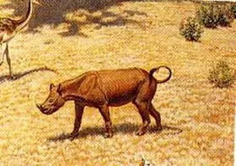
They have discovered all kinds of ancient animals there. When he is referring to rhino bones being found there, scientists today say it is this creature.

Slide 75
This is what the Agate Fossil Bed National Monument website says about them. https://www.nps.gov/agfo/learn/nature/mammalfossils.htm
“Rhinos were varied and abundant during most of the Cenozoic Era around the world. They ranged in size from the three-foot tall Menoceras of North America, to a giant Asian species. Another rhino species called Diceratherium also lived in this area on the grasslands, from 17 to 32 million years ago. Numerous bones of these animals were found in Carnegie's Quarry A, but very few were found in the waterhole bonebed. This suggests that this species may not have been trapped by the drought at the water source.
On the other hand, Monoceras was found by the thousands in the bonebed. About the size of a pony, Monceras, which was at first confused with Diceratherium, was much smaller than any modern rhino. Unlike modern rhinos which have two horns in a line (one in front of the other), a Monoceras male had two horns side-by-side at the end of its nose. Females did not have horns at all.”

Slide 76
“While some of the other mammal species were found with nearly complete skeletons, almost all the Monoceras bones were completely disjointed, scattered, and jumbled. This is probably because of aggressive scavanging of their carcases by Dinohyus, and because of ligaments decaying and allowing their bones to move freely in the water and mud of the drying waterhole.”

Slide 77
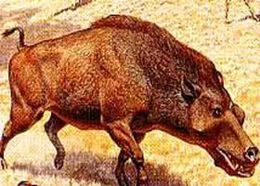
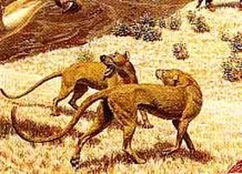
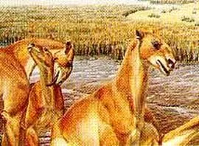
Other animals discovered there
Dinohyus-
A very large
Wild boar
Beardog-
hyena-type creature
Moropus-similar to modern day camels-they say a relative of the horse.

Slide 78
He writes, “it has been observed by such a competent geologist as Prestwich that these ossiferous fissures are usually found upon isolated hills of considerable height, places on which we might expect animals to gather in seeking safety from an approaching flood. Fleeing in terror and driven by the common danger, the carnivorous and herbivorous alike sought refuge on the same elevation, only to meet even here a common watery grave.”-p. 180

Slide 79
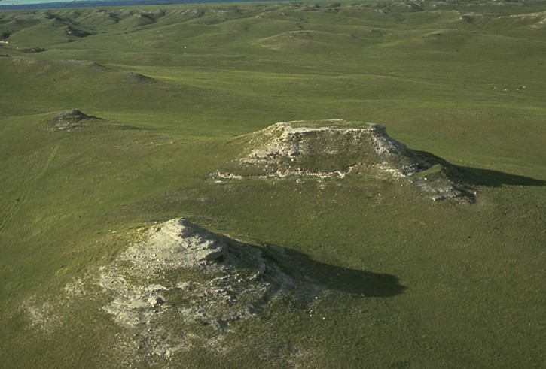
Here are pictures of this Agate site.

Slide 80
Of course, these kinds of sites exist in lots of places all over the Midwest. In South Dakota, you can visit the Mammoth site in Hot Springs, South Dakota. I went there as a kid. It was discovered when a crane operator in 1974 struck something that shown white in the sun. He discovered a mass grave for mammoths.

Slide 82
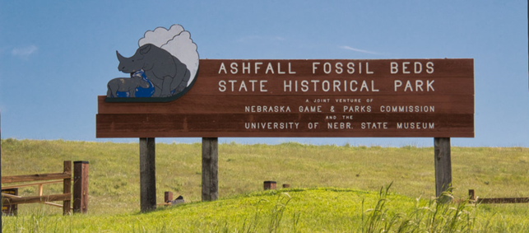
There is also a bone bed discovered in Ashfall, Nebraska.

Slide 83
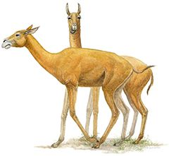
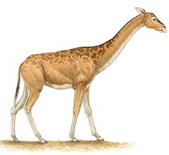
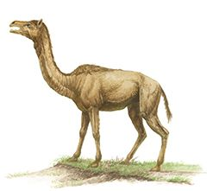
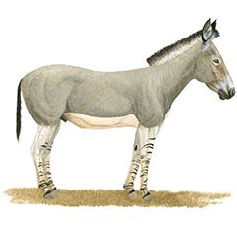
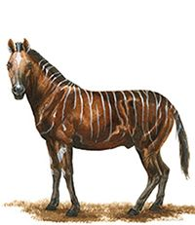
These are pictures of the types of animals discovered there.
Teleoceras major, Barrel-bodied rhino Most common animal
in the site
Protolabis heterodontus,
Primitive Llama-Sized Camel
Aepycamelus,
Giraffe-like camel
Procamelus grandis,
Ancestral camel
Cormohipparion occidentale,
Stout 3-toed horse
Protohippus simus,
Slender 1-toed horse

Slide 84
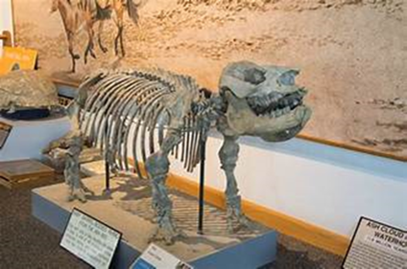

Slide 85
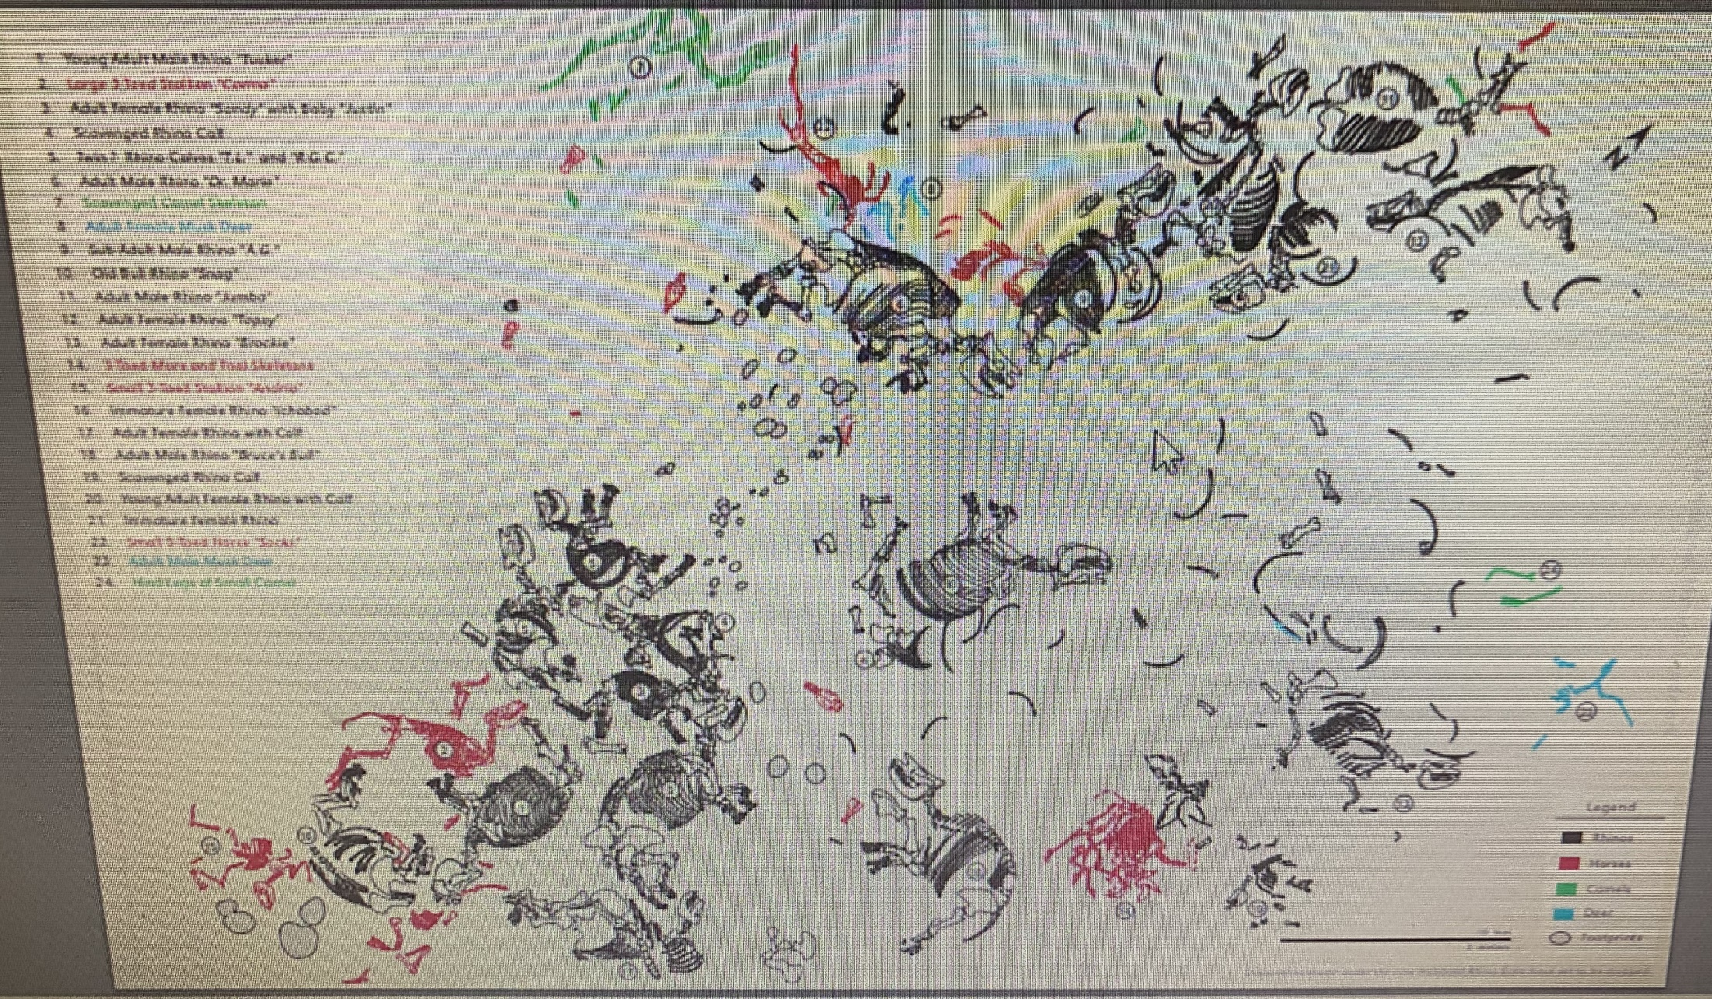

Slide 86
Now what I find interesting about these two sites in Nebraska is they are only approx. 300 miles apart, yet they claim to have found much different kinds of animals. However, if you look at the pictures they have created of them, they seem like pretty similar creatures to me. I have not studied them in-depth to know, but we know they can take a few bones and claim to have found a whole new animal when in fact they were just animals found today.
They also date the Fossil Bed site in Agate to 17 to 32 million years ago and the Ashfall site to 10-12 million. It is why they would say they are different animals.

Slide 87
Titanosaur found in Glen Allen Mo in 2017. Determined to have died in a flood—145 million years ago. Why not the flood 4500 years ago) Largest land-dweller ever found.

Slide 88
Could there be another explanation for why all these bonebed sites exist in many places of the Midwest? A flood would explain it, especially since modern-science places an ancient sea over Iowa and Wisconsin and the Midwest at one point.

Slide 89
Two summers ago, my family did a little trip through eastern Iowa to visit my folks who live in Northeast Iowa. On the way, we visited Spook Cave, located near McGregor Iowa, which is located along the Mississippi river. On the tour, the tour guide was pointing out marine fossils in the rocks above in the cave. He said it was from the Iowa ocean. I later asked him about this ocean and where it came from. He didn’t really know. He had just been told that by others.

Slide 90
In an article from the University of Iowa-College of Hydroscience and Engineering website, they talk about this mobile museum the University created highlighting this period in Iowa’s history.
This is what one of the professors writes on the site.

Slide 91
“Iowa Geological Survey research specialist Paul Liu and his team discovered that 465 million years ago, a meteorite had struck the Earth in the area that is now Decorah, Iowa. In the resulting crater, the researchers found an astonishing collection of exceptionally well-preserved fossils. The site represents one of only a few such “Lagerstätten” (the scientific term for a fossil deposit of this magnitude) from the Middle Ordovician period.
Liu explains that at that time, shallow saltwater covered much of what is now the Midwest. The area around Decorah was near the coast, where the water was less salty. Thus, distinctive organisms evolved to exist in the special conditions there. When the meteorite struck the Earth, the water near the crater’s seafloor became very still, brackish, and low in oxygen. Organisms in the water died and fell to the seabed, where they were preserved and laid undisturbed until Liu and his colleagues found them.”

Slide 92
“This opens a new window to tell us what Ordovician life was like,” Liu says.
One of the most dramatic finds was the sea scorpion, the earliest and largest such animal of that period, with a long head shield, a narrow curving body, and huge scary claw-like limbs that could easily trap the creature’s unfortunate prey. The sea scorpion’s modern relatives include spiders, lobsters, and ticks. Imagine a six-foot tick!”

Slide 93
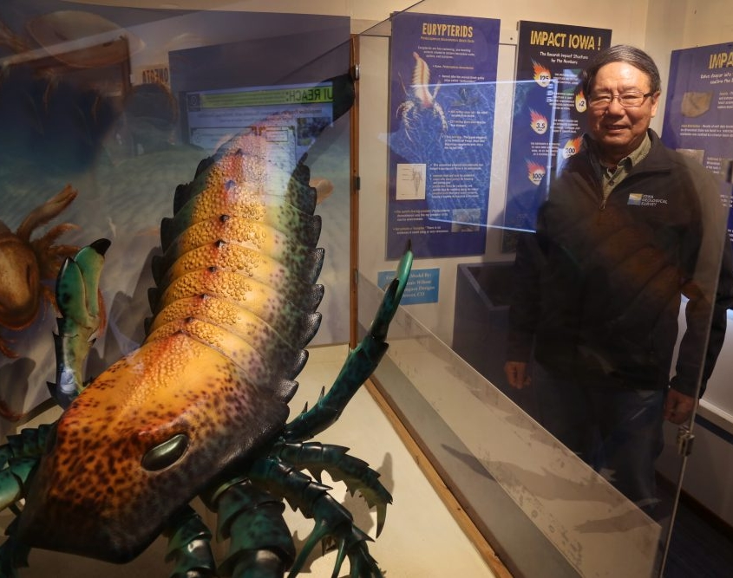
Now this is their picture of this creature

Slide 94
Now I would ask, how did that get in Iowa?
Also, where did all that salt water come from?
This is taken from the Iowa PBS wesbite
“Iowa has been under water in one form or another for much of its history. Ancient seas covered Iowa while it was located near the equator. For millions of years, the continental plate on which Iowa sits has slowly wandered around the globe. At one time the plate split apart, creating a rift. Then it moved back together. Several other times, it crashed into other plates. These crashes caused parts of the land to get pushed up out of the water. These earth-quaking events often formed mountains. The oldest mountain remnants in Iowa are found as Sioux Quartzite in the northwest corner of the state.

Slide 95
When the land was above water, waves and rain worked to wear away the rocks. When plates crashed together again, the land often got pushed back down. While underwater, the land became covered with layers of sediment. Each layer of sediment holds clues to the past. Some layers have fossil crinoids, trilobites or even tree pollen. Most of these layers are buried under newer rocks and soil. But the bluffs that line the Mississippi River in northeast Iowa are an exposed outcrop of ancient sea sediments.”
https://www.iowapbs.org/iowapathways/mypath/2667/iowas-geology

Slide 96
It certainly sounds like the remnants of an ancient flood and the great deep bursting forth moving plates to me.
In fact, if you visit Wisconsin Dells and do their wagon ride tour. It is called “Lost Canyon” tours, they will tell you the rock formations there were formed from water cutting down into the rock from an ancient sea, but they don’t explain how the sea got there or where it went.

Slide 97
This is from a sign in the Wisconsin Dells
“The word "Dells" was derived from the French word "Dalles," meaning flat-layered or slab rock. These layers of rock were formed during the Cambrian period, 500 million years ago, when the North American Continent was completely covered by an ocean, the Cambrian Sea. Layer upon layer of sand and silt formed on the bottom of this ocean and as the water receded, the layers of minerals solidified into sandstone. In the beginning of the Ice Age, approximately 1 million years ago, a series of glacial movements transformed the landscape, tearing of hill tops, filling valleys and leveling out the surface of the earth in the northern and eastern parts of Wisconsin. The Dells was located on the extreme eastern margin of a "drift less' area which was untouched by the glaciers. However, thousands of years later when the glaciers began to melt, the water formed enormous and powerful streams which pushed ice, rock and debris through the sandstone forming the spectacular rugged beauty of the river shorelines.”

Slide 98
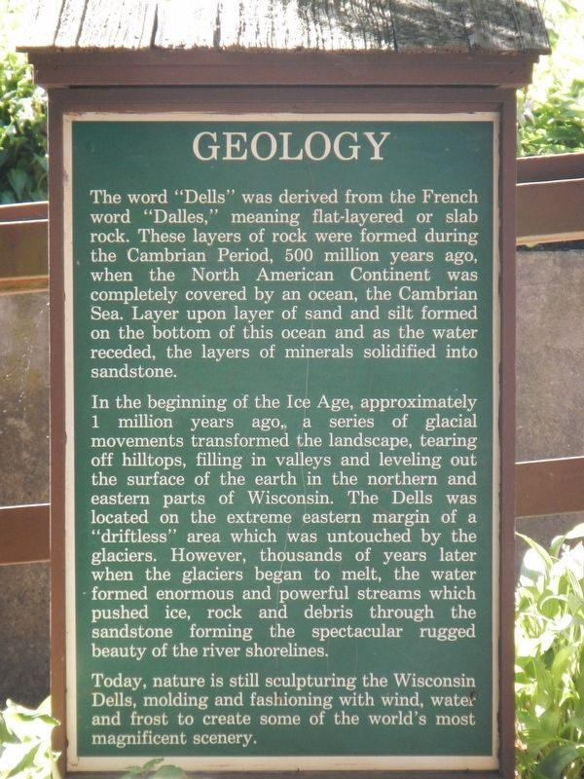
Here is a picture of the sign

Slide 99
Of course, Biblical Creationists argue that the theory of Pangea-the theory that the land of our earth was once all together can be explained by this breaking up due to the Flood. They argue that the land would have quickly moved apart from this break up, leading to continental divides we have today. This of course formed mountains and valleys relatively quickly.

Slide 100
The theory of the existence of a supercontinent they called Pangea was 1st theorized by a man named Alfred Wegener in 1912. Geography seems to support this. There are matching geological trends between the eastern coast of South America and the western coast of Africa. In addition, they say there is evidence in the fossil records. Excerpt from Wikipedia
“Fossil evidence for Pangaea includes the presence of similar and identical species on continents that are now great distances apart. For example, fossils of the therapsid Lystrosaurus have been found in South Africa, India and Antarctica, alongside members of the Glossopteris flora, whose distribution would have ranged from the polar circle to the equator if the continents had been in their present position; similarly, the freshwater reptile Mesosaurus has been found in only localized regions of the coasts of Brazil and West Africa.[20]”

Slide 101
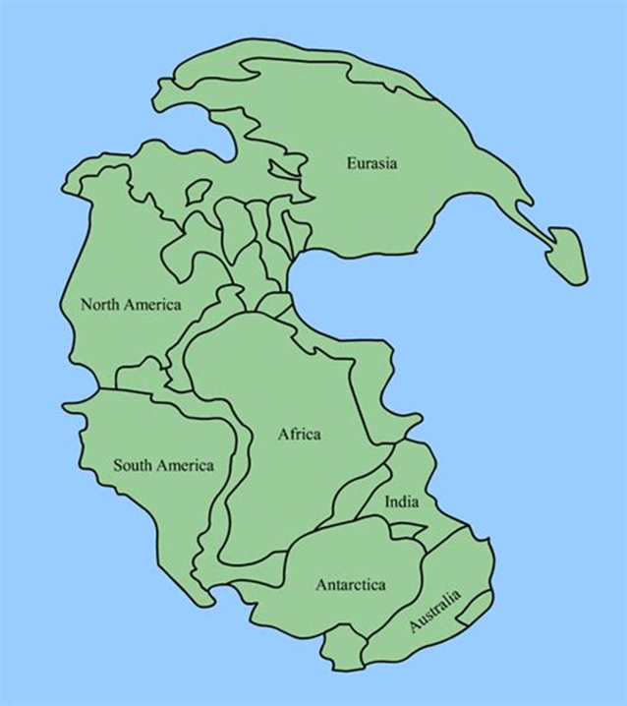

Slide 102
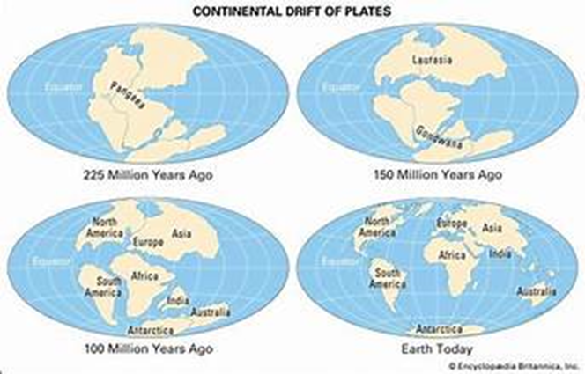

Slide 103
Another excerpt from Wikipedia
“Paleomagnetic study of apparent polar wandering paths also support the theory of a supercontinent. Geologists can determine the movement of continental plates by examining the orientation of magnetic minerals in rocks; when rocks are formed, they take on the magnetic properties of the Earth and indicate in which direction the poles lie relative to the rock.”-I cannot begin to explain the geology and science behind this, but it is pretty interesting.

Slide 104
“The continuity of mountain chains provides further evidence for Pangaea. One example of this is the Appalachian Mountains chain, which extends from the southeastern United States to the Caledonides of Ireland, Britain, Greenland, and Scandinavia.[22]”

Slide 105
Now how do we get from Pangea to the great distances between these continents now?
Well, we think under the right conditions the earth’s crust can move rapidly as plates break apart and move away from each other.

Slide 106
Dr. Andrew Snelling talks about this on the Answers in Genesis website. He writes,
“Investigations of the earth’s surface have revealed that it has been divided globally by past geologic processes into what today is a mosaic of rigid blocks called “plates.” Observations indicate that these plates have moved large distances relative to one another in the past and that they are still moving very slowly today.”

Slide 107
He goes into the history of plate tectonics and how a creationist named Antonio Snider in 1859 first proposed the idea of continental drift, however it was the same year as Charles Darwin’s “Origin of the Species”, so it didn’t get much publicity or thought.

Slide 108
He goes into how that Alfred Wegener, a German meteorologist, then proposed the theory to the scientific community and they took notice. For many years, the scientific community scoffed at this idea, but eventually it has come around because of the following evidence for it.

Slide 109
The jigsaw puzzle fit of the continents (taking into account the continental shelves);
The correlation of fossils and fossil-bearing strata across the ocean basins (e.g., the coal beds of North America and Europe);
The mirror image zebra-striped pattern of magnetic reversals in the volcanic rocks of the seafloor parallel to the mid-ocean rift zones in the plates on either side of the zone, consistent with a moving apart of the plates (seafloor spreading);
The location of most of the world’s earthquakes at the boundaries between the plates, consistent with earthquakes being caused by two plates moving relative to one another;

Slide 110
The existence of the deep seafloor trenches invariably located where earthquake activity suggests an oceanic plate is plunging into the mantle beneath another plate;
The oblique pattern of earthquakes adjacent to these trenches (subduction zones), consistent with an oblique path of motion of a subducting slab into the mantle;
The location of volcanic belts (e.g., the Pacific “ring of fire”) adjacent to deep sea trenches and above subducting slabs, consistent with subducted sediments on the tops of down-going slabs encountering melting temperatures in the mantle; and
The location of mountain belts at or adjacent to convergent plate boundaries (where the plates are colliding).

Slide 111
The evidence cannot be denied, however how does that get to the rapid movement that would have had to have happened for Pangea to become the continents we have today?

Slide 112
“A 3-D supercomputer model of processes in the earth’s mantle has demonstrated that tectonic plate movements can indeed be rapid and catastrophic when a realistic deformation model for mantle rocks is included. And, even though it was developed by a creation scientist, this supercomputer 3-D plate tectonics modeling is acknowledged as the world’s best.”

Slide 113
“The catastrophic plate tectonics model of Austin et al. begins with a pre-Flood supercontinent surrounded by cold ocean-floor rocks that were denser than the warm mantle rock beneath. To initiate motion in the model, some sudden trigger “cracks” the ocean floors adjacent to the supercontinental crustal block, so that zones of cold ocean-floor rock start penetrating vertically into the upper mantle along the edge of most of the supercontinent.”

Slide 114
“These vertical segments of ocean-floor rock correspond to the leading edges of oceanic plates. These vertical zones begin to sink in conveyor-belt fashion into the mantle, dragging the rest of the ocean floor with them. The sinking slabs of ocean plates produce stresses in the surrounding mantle rock, and these stresses, in turn, cause the rock to become more deformable and allow the slabs to sink faster. This process causes the stress levels to increase and the rock to become even weaker. These regions of rock weakness expand to encompass the entire mantle and result in a catastrophic runaway of the oceanic slabs to the bottom of the mantle in a matter of a few weeks.”

Slide 115
“The energy for driving this catastrophe is the gravitational potential energy of the cold, dense rock overlying the less dense mantle beneath it at the beginning of the event. At its peak, this runaway instability allows the subduction rates of the plates to reach amazing speeds of feet-per-second.”

Slide 116
I had a question during my last talk about whether Genesis 10:25 could be referring to this breaking up of the earth that caused the movement of Pangea.
It is the verse
^{ESV} Genesis 10:25 To Eber were born two sons: the name of the one was Peleg, for in his days the earth was divided, and his brother's name was Joktan.

Slide 117
In studying the use of the Hebrew word for earth, pronounced erets, it clearly has the meaning of "earth-as in ground or land"-found in Gen. 1:1, 1:10, 2:1, 2:5-6, 4:12.
^{ESV} Genesis 1:1 In the beginning, God created the heavens and the earth (erets).
^{ESV} Genesis 1:10 God called the dry land Earth (erets), and the waters that were gathered together he called Seas. And God saw that it was good.
It was the name God gave the land He created.

Slide 118
It could also in some cases stand for the people who existed on that land.
^{ESV} Genesis 6:11 Now the earth (erets) was corrupt in God's sight, and the earth (erets) was filled with violence.
Obviously, the ground or land had not become corrupt or had the capacity toward violence, but the people who dwelled on that earth became corrupt and violent.

Slide 119
In Genesis Chapter 10, it tends to have more the meaning of the land that people dwell on or possess.
^{ESV} Genesis 10:10 The beginning of his kingdom was Babel, Erech, Accad, and Calneh, in the land (erets) of Shinar.
^{ESV} Genesis 10:11 From that land (erets) he went into Assyria and built Nineveh, Rehoboth-Ir, Calah, and
^{ESV} Genesis 10:20 These are the sons of Ham, by their clans, their languages, their lands (erets), and their nations.

Slide 120
Continuing…
^{ESV} Genesis 10:31 These are the sons of Shem, by their clans, their languages, their lands (erets), and their nations.
Given the use then of erets in Genesis 10, it would seem more appropriate from its near context to translate the verse like this,
"for in his days, the land was divided."

Slide 121
In fact, we think Peleg’s was named for this division. His name means "divided", the Hebrew word used for his name has the same root as the verb used.
Wenham-"Peleg' comes from the root GLP, 'to divide', as a common noun it means 'channel'. Here the etymology gives it a more abstract sense, 'division'. Like many Biblical names, this is prophetic, in that it foreshadows the great events that would take place in Peleg's lifetime."-p. 230

Slide 122
But what events?
Wenham says "the earth" denotes the peoples of the world. But in what sense was it divided? Some suggest that the division was between the sons of Peleg, i.e. sedentary agriculturalists, who depended upon irrigation channels. and the sons of Joktan, wandering Arab tribes. More likely, it refers to the dispersal of the nations at Babel (11:1-9). Admittedly, the verb used there, 'disperse' is not 'to divide'. But GLP can be used of confusing speech (Psalm 55:9). Peleg could also be taken as a place name."-p. 230-231.

Slide 123
^{ESV} Psalm 55:9 Destroy, O Lord, divide their tongues; for I see violence and strife in the city.
This is the verse he is referring too. The Hebrew word for “divide” is the same Hebrew word in its verbal form as Genesis 10:25.

Slide 124
Matthew Henry's Commentary- "was the earth divided among the children of men that were to inhabit it; either when Noah divided it by an orderly distribution of it, as Joshua divided the land of Canaan by lot, or when, upon their refusal to comply with that division, God, in justice, divided them by the confusion of tongue: whichsoever of these was the occasion, pious Heber saw cause to perpetuate the remembrance of it in the name of his son; and justly may our sons be called by the same name, for in our days, in another sense, is the earth, the church, most wretchedly divided."-p. 78
Our Lutheran Study Bible text note thinks it is referring to when the earth was divided by the confusion of tongues.

Slide 125
Therefore, it is possible that the verse could be referring to the division of the earth of Pangea, but the context and timing would suggest either the division of lands or the division of peoples on those lands due to God confusing their languages as recorded in Genesis 11. It is always best to the let the near context guide you in understanding the meaning of a word and how it is being used in the flow of a narrative.

Slide 126
Of course, the existence of Pangea would explain how all the animals could have gotten to the ark without any problems.
Now how did they get to their present locations? One might ask about the Koala’s in Australia.

Slide 127
I picked up a book at the Ark Encounter entitled, “A Flood of Evidence”. His theory is that a large number of marsupials ended up in Australia, like koalas. Why? It is because they could travel farther and faster than other species because they didn’t have to stop and feed their young. Also, we believe there could have been land bridges that existed then that no longer exist today. Perhaps the marsupials were able to travel across these land bridges sooner before they later closed.

Slide 128
We know if the theory of Pangea is correct that they could have just returned back to where they came from and somehow the Lord provided for them to arrive. Also, he argues that the sea level would have been lower following the flood for a time because it caused the ice age. He says because more water was trapped on land, the ocean levels would have been lower, perhaps allowing for land bridges. There is also the possibility of them traveling on ice or floating debri or over parts that were frozen over then, but not now.

Slide 129
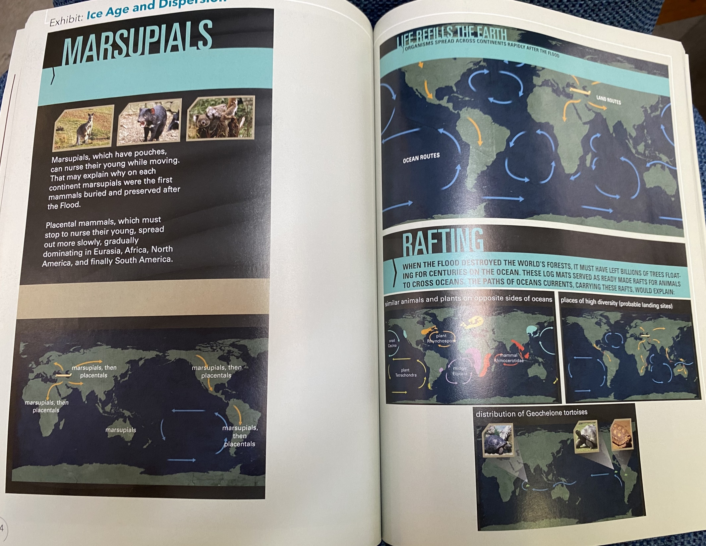

Slide 130
Now what would lend itself to very quick movement of the plates and earth’s crust would also be this “bursting forth.” As the Lord split up the “great deep”, it could also account for this movement and the evidence for it in the world, especially since fossils of the same types of animals are found on multiple continents.

Slide 131
Therefore, to recap.
We know God’s Word says there was a splitting up, a bursting forth of the great deep causing “the springs or fountains” to come forth from that deep.
We see evidence all over the world of earthquakes and volcanoes and the breaking up of land masses in previous times.
We know this “bursting forth”, if it was in the form of earthquakes and volcanoes can greatly affect weather, causing large amounts of rainfall and the cooling of regions.
Of course, this is how we then explain the Ice Age as creationists. It was as a result of these massive changes that would have dramatically cooled areas of the world, freezing the large amount of water that covered the earth.

Slide 132
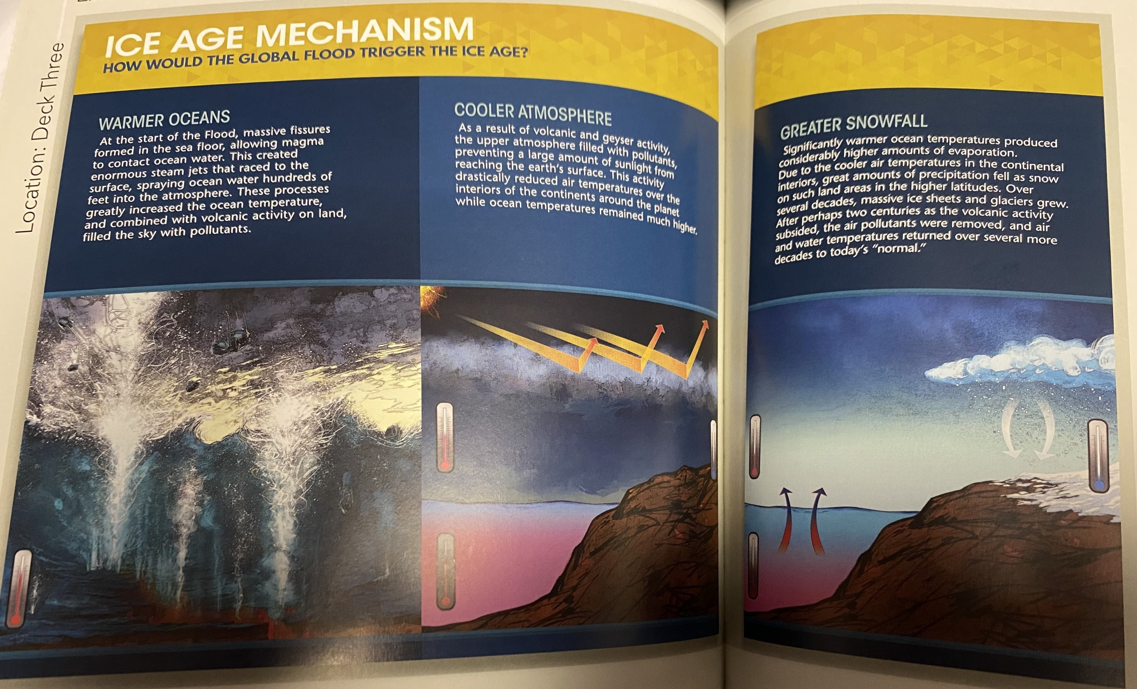

Slide 133
We have modern day examples of great localized floods or volcanoes that did a significant amount of geological change and movement in a short amount of time. Mount St. Helens is a modern day example.

Slide 134
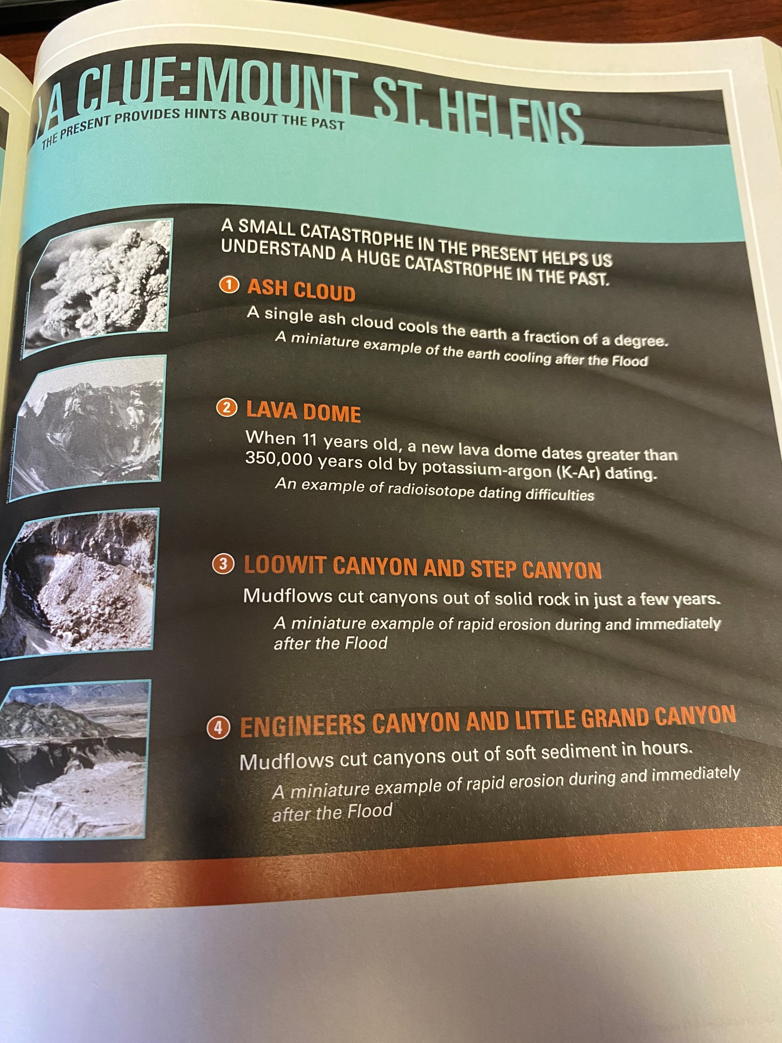

Slide 135
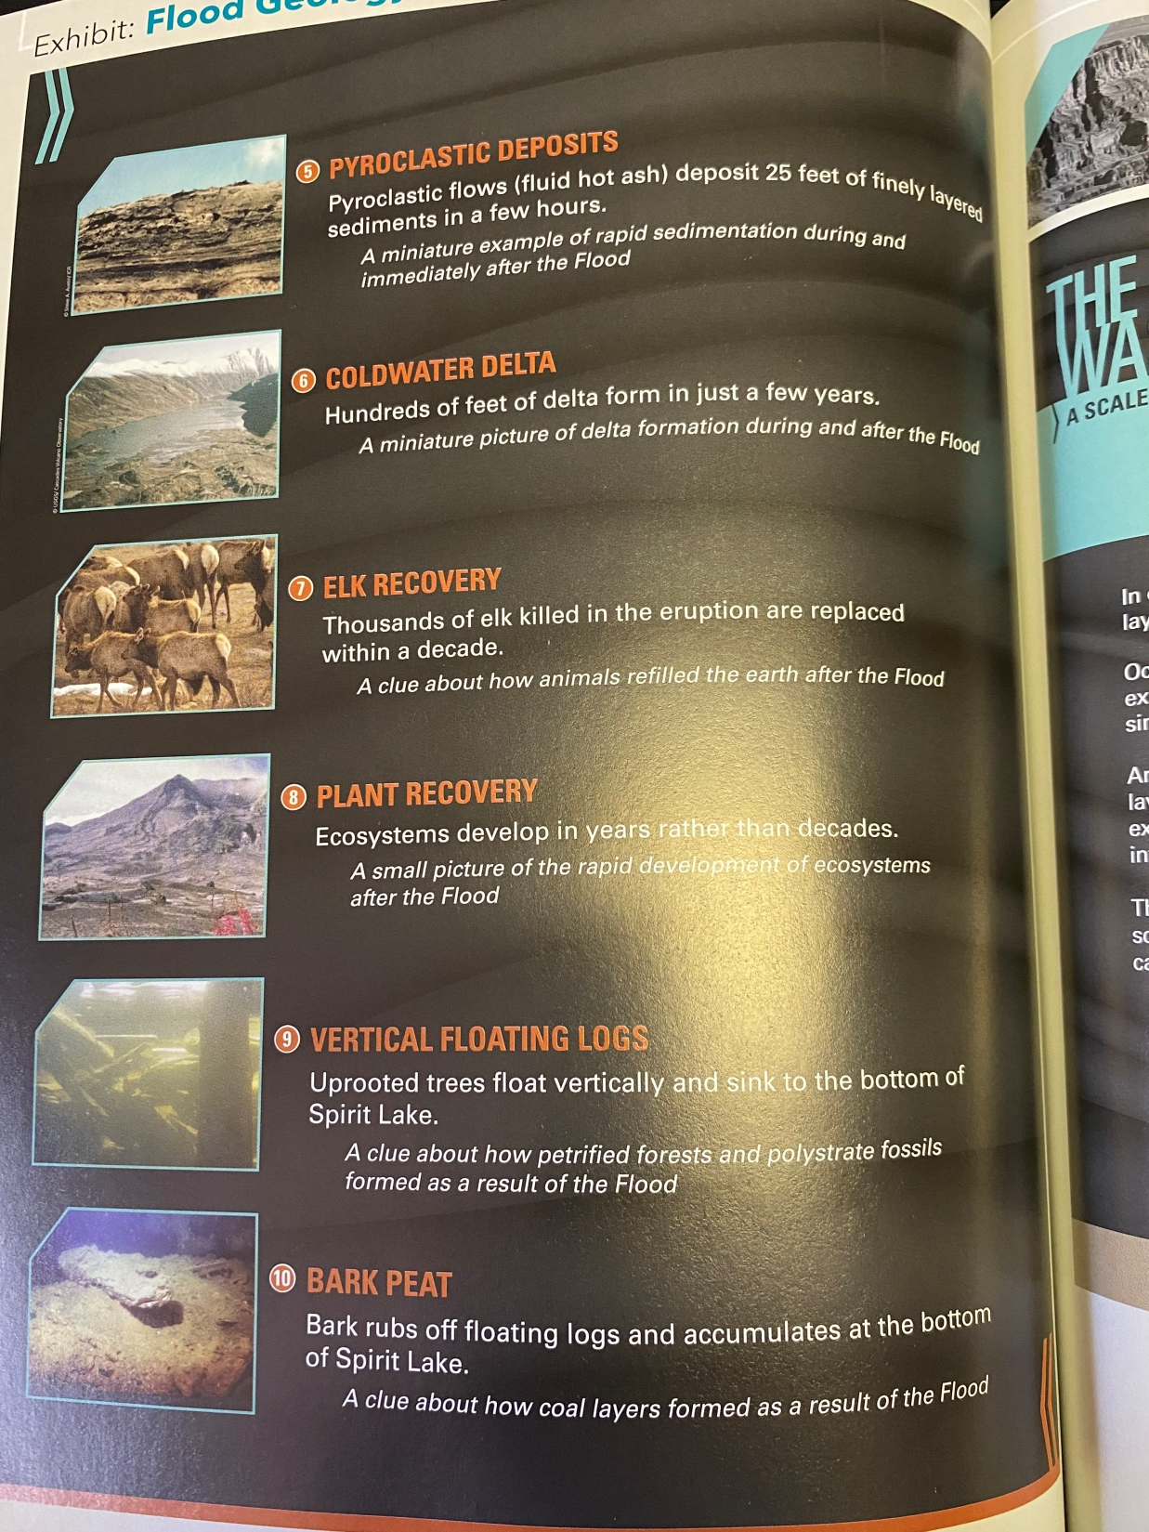

Slide 136
Also, think about all the animals and humans buried in a very short amount of time in mud and under rock. This provides another evidence for a world wide flood. Marine life fossils are found on mountains or at high elevations, like the Himalayas. Spots can be found where many animals seem to be buried together.

Slide 137
Except from Answers in Genesis article entitled, “Flood Evidence Number One: High and Dry Sea Creatures.”
“Marine fossils are also found high in the Himalayas, the world’s tallest mountain range, reaching up to 29,029 feet (8,848 m) above sea level.3 For example, fossil ammonites (coiled marine cephalopods) are found in limestone beds in the Himalayas of Nepal. All geologists agree that ocean waters must have buried these marine fossils in these limestone beds. So how did these marine limestone beds get high up in the Himalayas?”

Slide 138
Except from Answers in Genesis article entitled, “Flood Evidence Number One: High and Dry Sea Creatures.”
“It is beyond dispute among geologists that on every continent we find fossils of sea creatures in rock layers which today are high above sea level. For example, we find marine fossils in most of the rock layers in the Grand Canyon. This includes the topmost layer in the sequence, the Kaibab Limestone exposed at the rim of the canyon, which today is approximately 7,000–8,000 feet (2,130–2,440 m) above sea level.1 Though at the top of the sequence, this limestone must have been deposited beneath ocean waters loaded with lime sediment that swept over northern Arizona (and beyond).”

Slide 139
Interestingly, the explanation of secular scientists is that the animals were fossilized in a particular rock layer and then the mountains were pushed up over millions of years with those fossils present in them. Their explanation for the Grand Canyon is that the Colorado River has slowly cut away at the rock over these millions of years. The explanation for these sea creatures is that the top layer used to be the sea floor. However, this is not how the National Park Service website talks about that upper level.

Slide 140
According to the National Park’s Service website, they would claim the youngest layers of rock are on the top.
“The story of how the Grand Canyon came to be begins with the formation of the layers and layers of rock that the canyon winds through. The story begins about 2 billion years ago when igneous and metamorphic rocks were formed. Then, layer upon layer of sedimentary rocks were laid on top of these basement rocks. To look at rock layers, geologists use a diagram called a stratigraphic column. It shows the rock layers with the oldest on the bottom, and the youngest on the top. That means that the bottom layer was formed first, and every subsequent layer was formed later, with the youngest rocks on the top.”

Slide 141
Further explanation from the National Park’s Service website.
The Uplift of the Colorado Plateau The Kaibab Limestone, the uppermost layer of rock at Grand Canyon, was formed at the bottom of the ocean. Yet today, at the top of the Colorado Plateau, the Kaibab Limestone is found at elevations up to 9,000 feet. How did these sea floor rocks attain such high elevations? Uplift of the Colorado Plateau was a key step in the eventual formation of Grand Canyon. The action of plate tectonics lifted the rocks high and flat, creating a plateau through which the Colorado River could cut down. The way in which the uplift of the Colorado Plateau occurred is puzzling. With uplift, geologists generally expect to see deformation of rocks. The rocks that comprise the Rocky Mountains, for example, were dramatically crunched and deformed during their uplift. On the Colorado Plateau, the rocks weren’t altered significantly; they were instead lifted high and flat. Just how and why uplift occurred this way is under investigation. While scientists don’t know exactly how the uplift of the Colorado Plateau occurred, a few hypotheses have been proposed. The two currently favored hypotheses call for something called shallow-angle subduction or continued uplift through isostacy.

Slide 142
Questions that need to be asked? 1. Where did the sea go if it used to be the sea floor? 2. What would have caused such a large uplifting? It cannot be explained like other mountains on continental divides. 3. Think about how large the Colorado had to have been if that is the sole explanation for the Canyon. It had to have been a huge lake size that slowly decreased to its present size. Where did all the water come from? Where did it go? 4. Some of the geology in the canyon goes against modern understanding of geology unless a massive, catastrophic flood event with lots of water happened. Articles in Answers in Genesis

Slide 143
There is also evidence in the fossil records of animals being fossilized very quickly. Such as a sea creature called a icthyosaur, discovered fossilized while giving birth to its young or a fish fossilized while eating another fish. Look at picture on the next slide.

Slide 145
Of course, much more could be said and written about the evidence for a world-wide flood, but it is clear from Genesis there was a world-wide flood and I hopefully have argued there is plenty of evidence to support the Biblical account of how the flood occurred.
Any questions?

